Slide 3
cardiovascular system
cell
digestive system
excretory system
function
muscular system
nervous system
organ
reproductive system
respiratory system
skeletal system
structure
system (body system)
tissue

Slide 4
Brainstorm
Take one minute to brainstorm a list of organs that are found in the human body.
Record your list in your notebook.

Slide 5
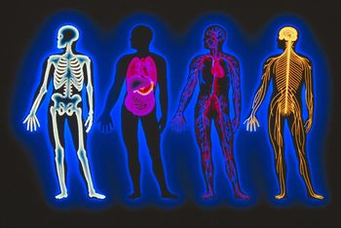
Read the introduction and look for key ideas

Slide 6
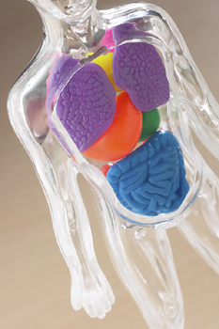
What do you know about the organs and systems of the human body?

Slide 7
Organs
Organs of the body have specialized structures for performing their specific functions.

Slide 8
Complete procedure part A
Make sure each person in your group draws three organs.

Slide 9
Complete procedure part B steps 5-9
After step 9, discuss with the class your classification of the organs.

Slide 10
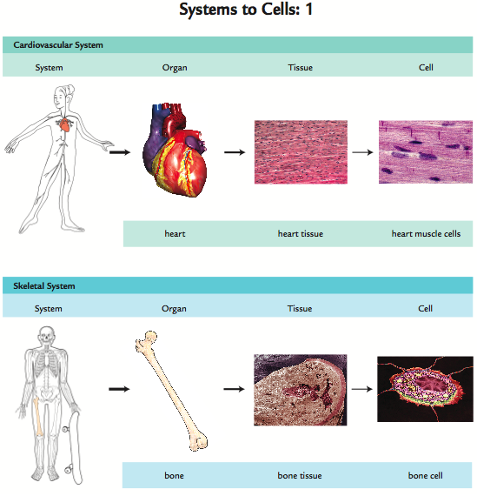
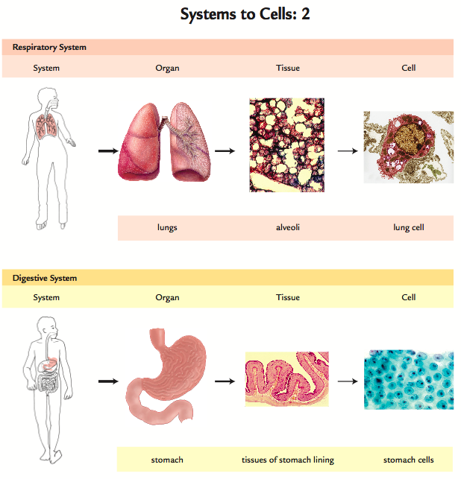
Systems to cells

Slide 11
Complete procedure part B steps 10-14
Be sure to listen to your group members.

Slide 12
Part C
Looking at your drawings from Part A, What is in the empty space?
Share your thoughts with the class.

Slide 13
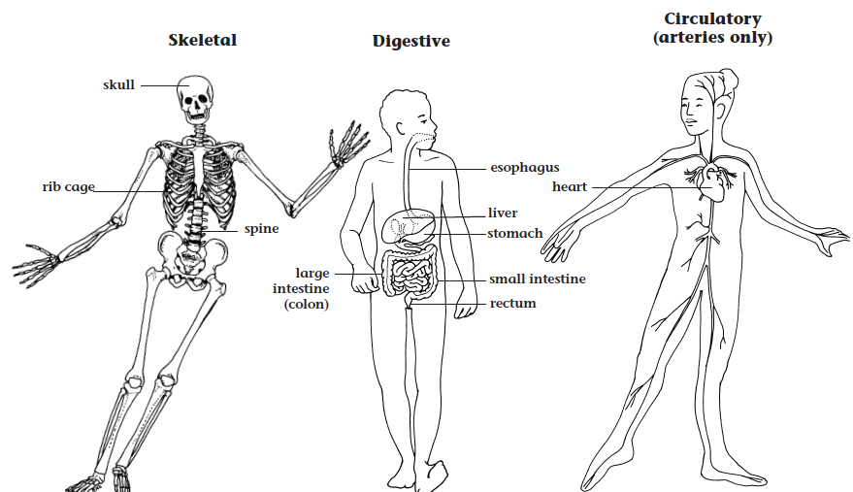
Complete procedure part C

Slide 14
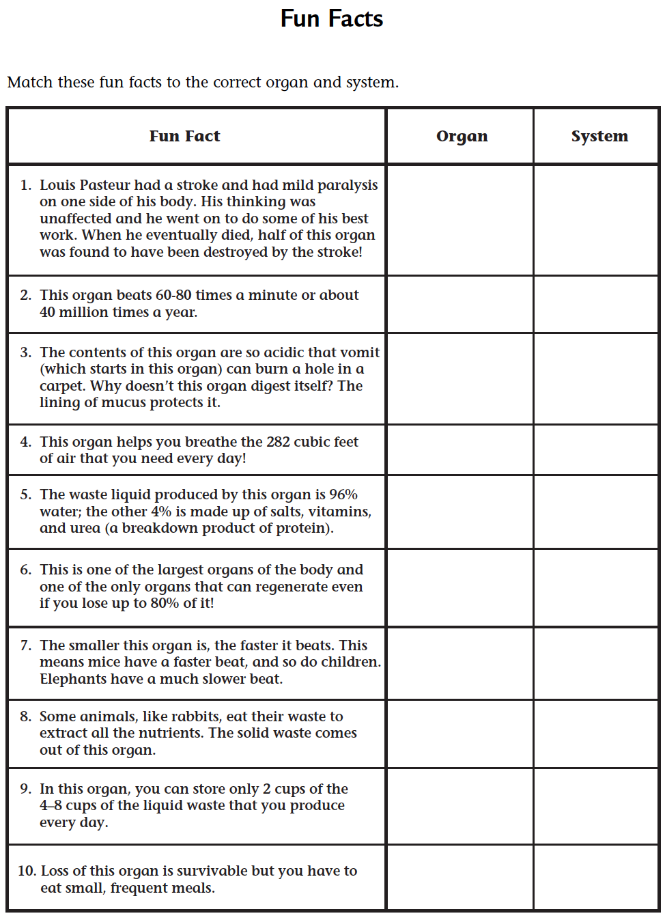
Complete procedure part D

Slide 15
Analysis question 1
Look at the drawing that you made in Part A. List some structures or organs that were not the right shape or size or were in the wrong place on your original drawing. Explain how you would change them if you could redraw the diagram.

Slide 16
Analysis question 2
Look at the questions that you recorded in your science notebook after Part A. Answer all of the questions that you can answer. Discuss with your group any that you are still not sure about.

Slide 17
Analysis question 3
The liver is the largest internal organ of the human body. Was the liver the largest organ in your clay model? Do you think that the other organs you modeled in the clay were accurate in size? Why or why not?

Slide 18
Analysis question 4
What are some of the limitations of the clay model you made of the human body in Part C?

Slide 19
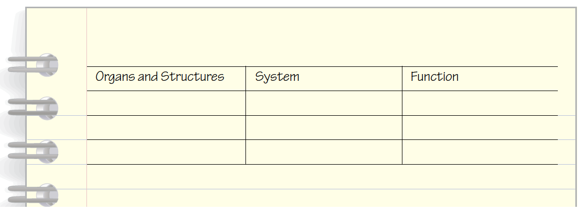
Analysis question 5
Prepare a table with headings as shown below. Fill in the first column with the organs or structures listed in Table 1.

Slide 20
Analysis question 5
a. In the second column of your table, identify the system that matches each organ or structure. For example, the stomach is a part of the digestive system.
b. In the third column of your table, identify the function of each of the systems you mentioned in 5a.

Slide 21
Analysis question 6
Imagine a younger student did not understand the difference between the body’s organs and systems. Explain the relationship in a way that a
younger student could understand.

Slide 22
Analysis question 7
Reflection: What new things have you learned about the human body in this activity?

Slide 23
What do you know about the organs and systems of the human body?

Slide 24
Key Vocabulary definitions
Cardiovascular system - Closed circulatory system, characteristic of vertebrates, that includes one or more hearts and a branching network of arteries, capillaries, and veins.
Cell - The smallest structural unit enclosed by a membrane that makes up all living organisms.

Slide 25
Key Vocabulary definitions
Digestive system - An integrated system consisting of specialized organs responsible for the ingestion, digestion, and absorption of food.
Excretory system - An integrated system consisting of specialized organs responsible for the removal of excess or harmful solutes, waste products, and excess water.

Slide 26
Key Vocabulary definitions
Function - The specialized activities performed by a system, organ, body part, or device.
Muscular system - The system of muscles that help various parts of the body to move.

Slide 27
Key Vocabulary definitions
Nervous system - The body organ system in animals that coordinates and controls the actions of internal organs and body systems by receiving and processing sensory information from the external environment, and coordinating short-term reactions to these stimuli.

Slide 28
Key Vocabulary definitions
Organ - A collection of tissues which performs a particular function or set of functions.
Reproductive system - The system of organs and structures necessary for sexual activity and the production of offspring.

Slide 29
Key Vocabulary definitions
Respiratory system - The system of organs that work together to take oxygen into the body and to remove carbon dioxide from the body.
Skeletal system - The organ system consisting of bones, cartilage, ligaments, and tendons that provide a rigid, supportive, and protective structure for an organism.

Slide 30
Key Vocabulary definitions
Structure - The way that an organ or body part is made up, including its shape and the types of tissues or other substructures that form it.
System (body system) - A group of organs that work together to perform a specific function.

Slide 31
Key Vocabulary definitions
Tissue - A group of similar cells and cellular material that perform a particular function.

Slide 32
Human body systems
Find out more about the human body and its systems on the Issues and Life Science page of the SEPUP website.
www.sepuplhs.org

