Slide 3
organ
regulation/regulate
systems
toxin

Slide 4
What do you know about your liver?
Record your answer in your notebook.

Slide 5
How can information about how your body functions help you?
Share your thoughts with the class.

Slide 6
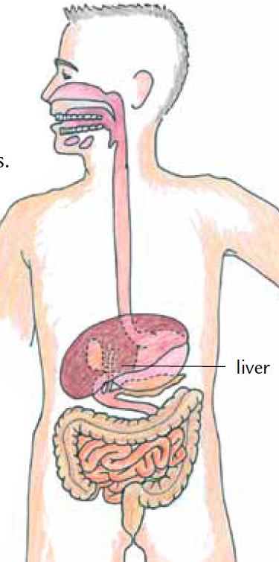
Read the introduction and look for key ideas

Slide 7
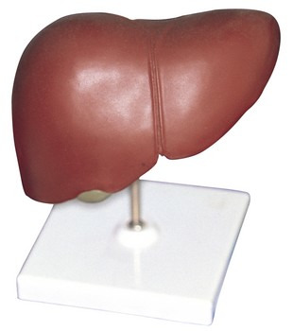
How does the liver help your body stay in balance?

Slide 8
Read the role-play
Complete procedure steps 1-3 with your group.

Slide 9
Analysis question 1
What are some of the functions of the liver?

Slide 10
Analysis question 2
People who have cirrhosis of the liver are usually on a strict diet. They have to be careful of what they eat and drink. Why do you think this is?

Slide 11
Analysis question 3
How can understanding how your liver works help you make decisions about your health?

Slide 12
How does the liver help your body stay in balance?

Slide 13
Key Vocabulary definitions
Organ - A collection of tissues which performs a particular function or set of functions.
Regulation/regulate - The process of keeping chemicals and conditions in the body balanced.

Slide 14
Key Vocabulary definitions
System - A group of organs that work together
to perform a specific function.
Toxin - A chemical produced by one organism that is harmful to another organism.

Slide 15
Liver
For links to more information about the liver, go to the Issues and Life Science page of the SEPUP website.
www.sepuplhs.org

