Slide 3
chemical breakdown
control
digestive system
function
hypothesis
mechanical breakdown
model
organ
qualitative/ quantitative data
surface area (optional)
variable

Slide 4
When the cube at left is cut into 8 equal cubes, the total volume stays the same. Which has more surface area, the original cube or the set of 8 cubes?

Slide 5
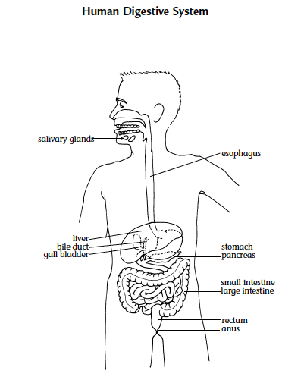
What are the major functions of the digestive system?
Share your thoughts with the class.

Slide 6
Breakdown
Two types of breakdown:
Mechanical breakdown – food is physically broken down into smaller pieces
Chemical breakdown – particles of food are broken down by chemicals.

Slide 7
Why is breakdown important?
Share your thoughts with the class.

Slide 8
Read the introduction and look for key ideas

Slide 9
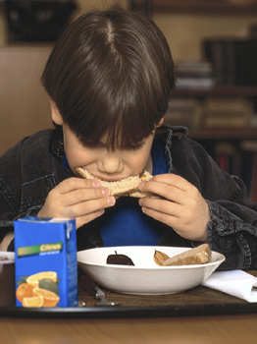
Why is it important to chew your food?

Slide 10
Complete procedure part A and record your data

Slide 11
How did you decide when the chemical breakdown was over?
Did you observe or record how long it took before the tablet piece completely dissolved?
Share your results with the class.

Slide 12
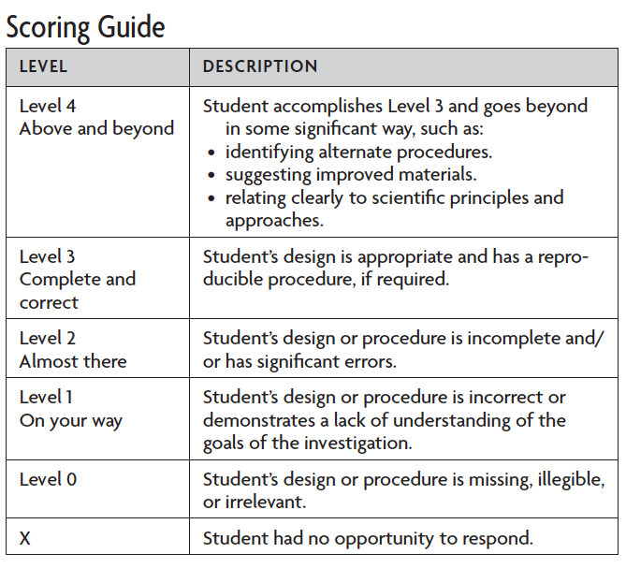
Complete procedure part B
Designing Investigations

Slide 13
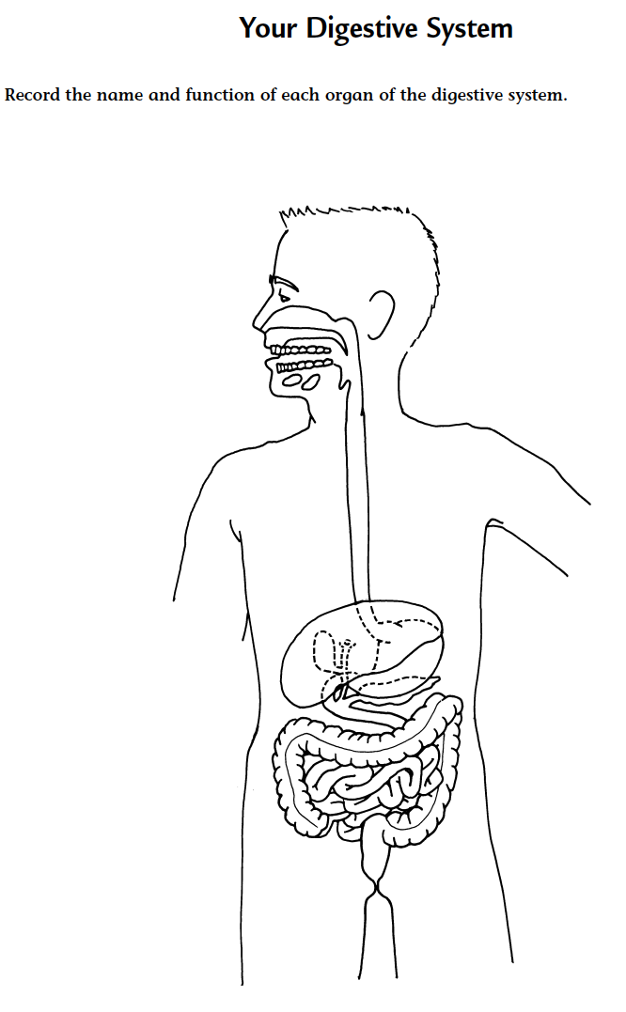
Digestive system
Trace the path food takes through the digestive system.

Slide 14
Analysis question 1
a. In your experiment, what variables did you keep the same?
b. Were there any variables (except for the one being tested) that you could not keep the same?
c. How could you or did you improve the design of your experiment? Explain.

Slide 15
Analysis question 2
a. What part of digestion was modeled by breaking the tablet?
b. What part of digestion was modeled by adding vinegar?

Slide 16
Analysis question 3
a. What qualitative data did you collect?
b. What quantitative data did you collect?

Slide 17
Analysis question 4
How does the size of your food affect the speed at which chemical breakdown occurs? Explain how your conclusions are based on the data collected during your experiment, and whether your hypothesis was supported or disproved.

Slide 18
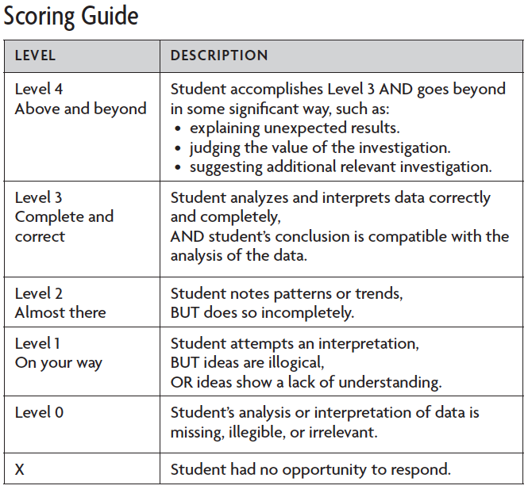
SCORING GUIDE: Analyzing Data

Slide 19
Analysis question 5
Besides preventing choking, why is it important to chew your food?

Slide 20
Why is it important to chew your food?

Slide 21
Key Vocabulary definitions
Chemical breakdown - The breaking up of larger molecules into smaller ones through the action of chemicals (for example, hydrochloric acid, enzymes).

Slide 22
Key Vocabulary definitions
Control - A standard of comparison for checking or verifying the results of an experiment. In the parallel experiment a single variable is changed. The results are compared to the control in order to see if the variable had any effect.

Slide 23
Key Vocabulary definitions
Digestive system - An integrated system consisting of specialized organs responsible for the ingestion, digestion, and absorption of food.
Function - The specialized activities performed by a system, organ, body part, or device.

Slide 24
Key Vocabulary definitions
Hypothesis - A possible explanation for observations, facts, or events, that may be tested, verified, or answered by further investigation.

Slide 25
Key Vocabulary definitions
Mechanical breakdown - The purely physical process of breaking down larger substances into smaller pieces without changing the chemical composition of the substance.
Model - Something that is used to describe a larger or smaller object; a description of an event or object that accounts for all its properties.

Slide 26
Key Vocabulary definitions
Organ - A collection of tissues which performs a particular function or set of functions.
Qualitative - Information that is concerned with qualities, not numbers or quantities.
Quantitative - Information that is based on numerical measurements.

Slide 27
Key Vocabulary definitions
Surface area - The part of a structure that is exposed. For example, during digestion, mechanical breakdown of food increases the surface area of the food so that more of it is exposed to chemicals and is therefore digested more quickly. Increasing the surface area of a liquid speeds up the rate of evaporation or absorption.

Slide 28
Key Vocabulary definitions
Variable - The only factor in a scientific experiment that is different from the control group.

