Slide 3
absorb, absorption
chemical breakdown
cross-section (optional)
digestive system
function
mechanical breakdown
organ
nutrients
tissue
toxins

Slide 4
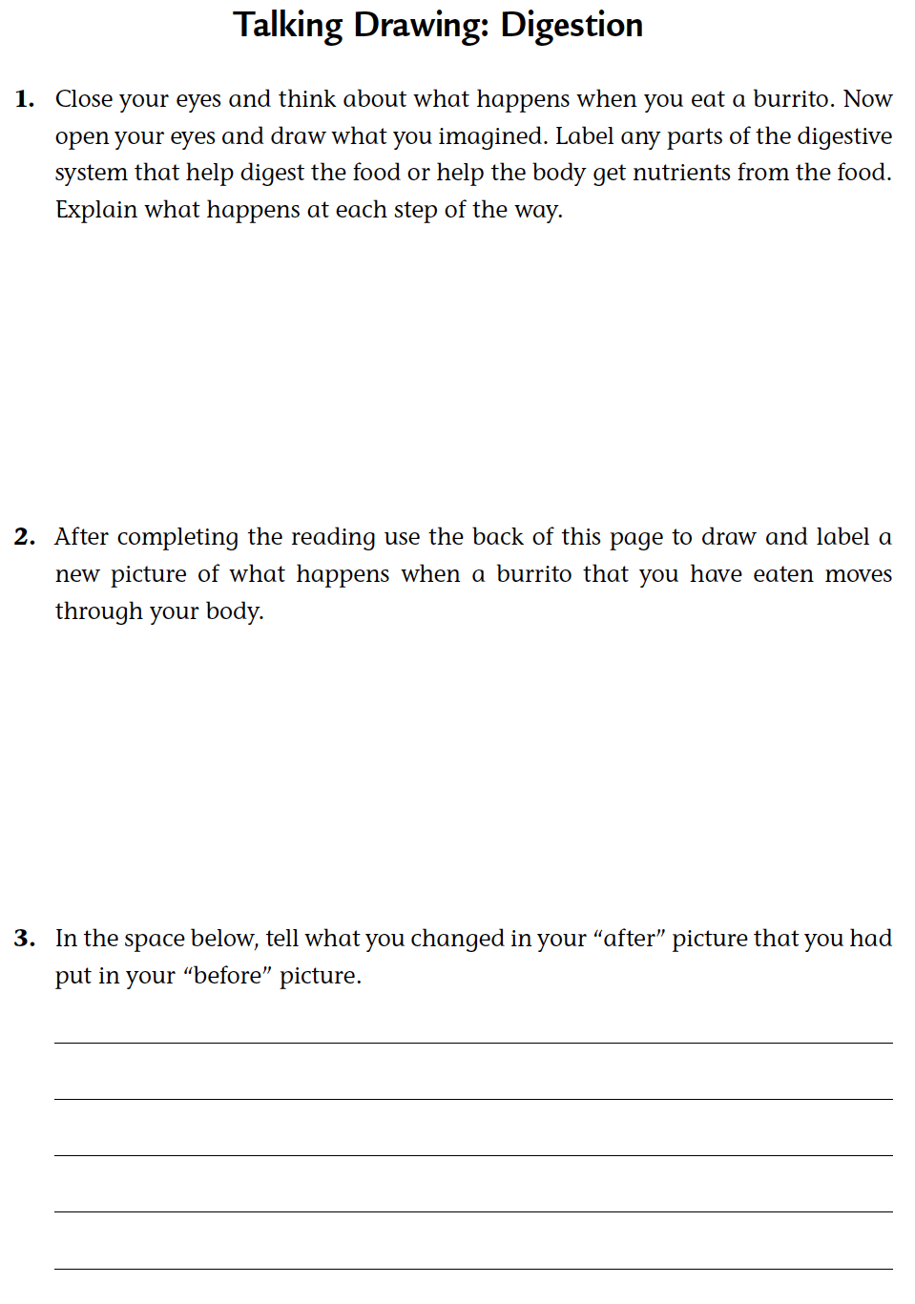
Talking drawing
Complete the first part of Student Sheets 15.1, “Talking Drawing: Digestion.”

Slide 5
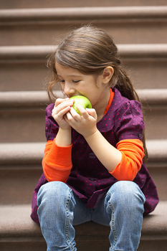
Read the introduction and look for key ideas

Slide 6
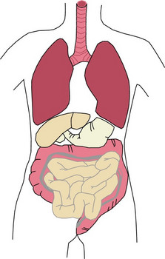
How does your digestive system work?

Slide 7
Complete the reading
Use Student Sheet 14.1, “Your Digestive System,” to label the organs and their functions as you complete the reading.

Slide 8
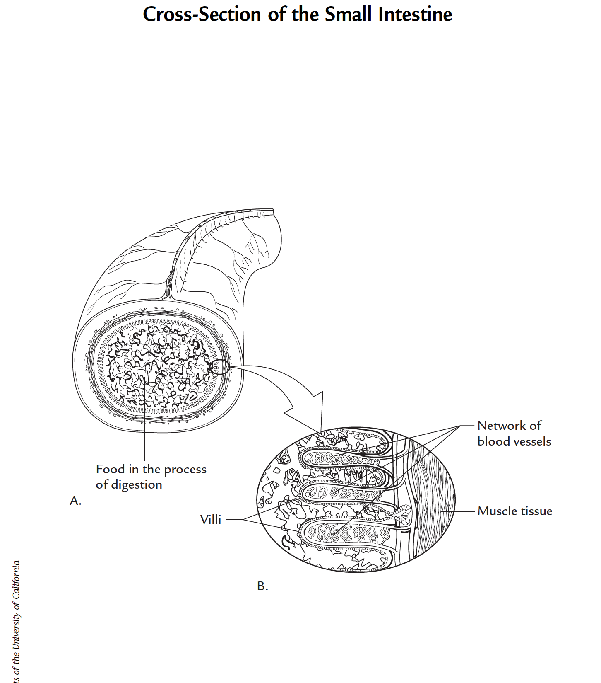
Small intestine

Slide 9
Stopping to think 1
a. How does your mouth contribute to the process of digestion?
b. Explain how your stomach helps break down food.

Slide 10
Stopping to think 2
a. Explain the relationship between food and nutrients.
b. What role(s) does your small intestine play in digestion?

Slide 11
Sopping to think 3
Why does blood travel to your liver before transporting nutrients to other parts of your body?

Slide 12
Stopping to think 4
The reading describes three components of human solid waste. Which two of these do you think are the main components?

Slide 13
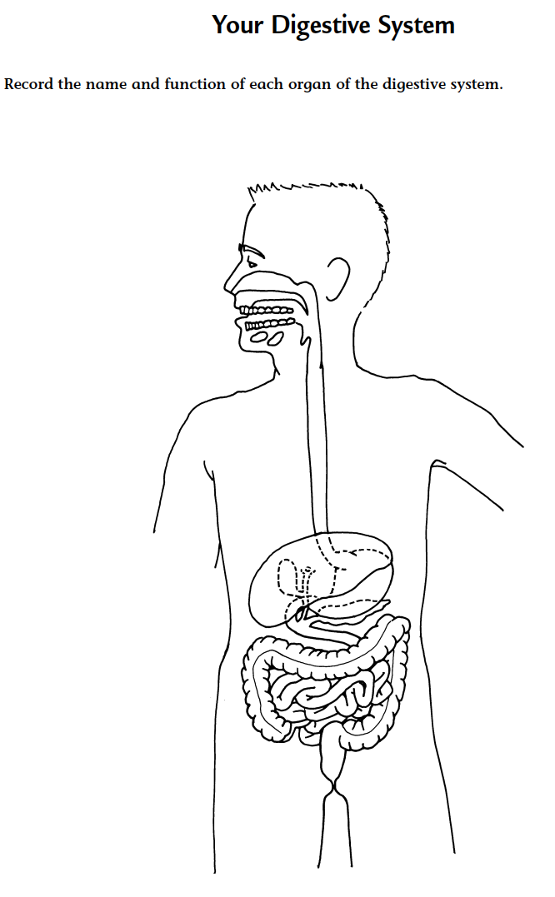
How does each organ help you to digest food?
How do nutrients get
from the digestive system
to the rest of the organs
in my body?

Slide 14
Stomach and small intestines
Compare the structure of the stomach and small intestines.
Based on your knowledge of their functions, explain their difference in structure or shape.
Share your thoughts with the class.

Slide 15
Small intestine
Compare the structure of
the stomach and small intestine.
Based on your knowledge of
their functions, explain their
difference in structure or shape.

Slide 16
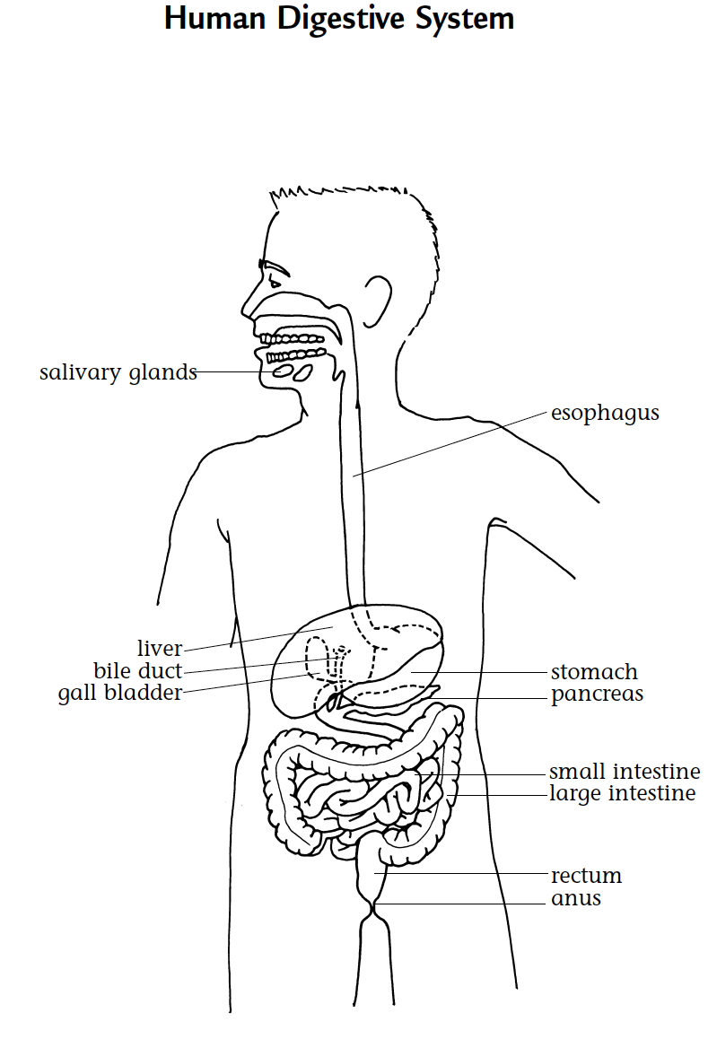
Digestive system
Review the functions of
each part of the digestive
system.

Slide 17
Talking drawing
Complete parts 2 and 3 of Student Sheet 15.1, “Talking Drawing: Digestion.”

Slide 18
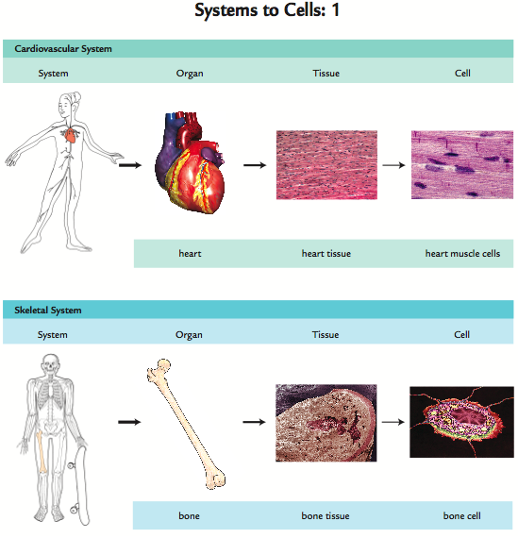
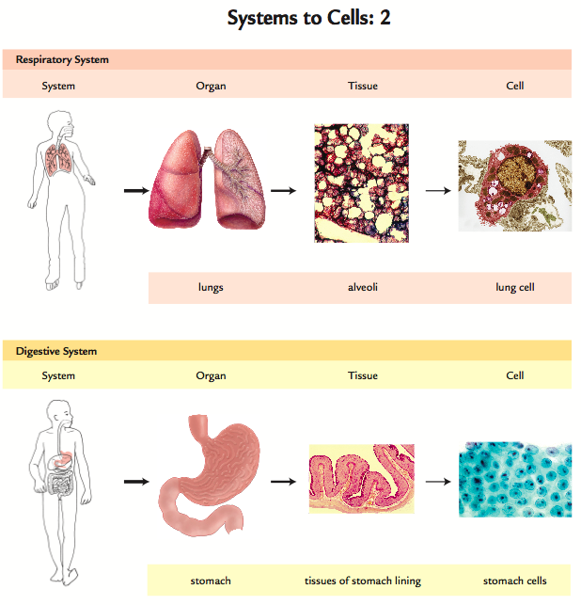
Systems to cells

Slide 19
Analysis question 1
What are some of the functions of the digestive system?

Slide 20
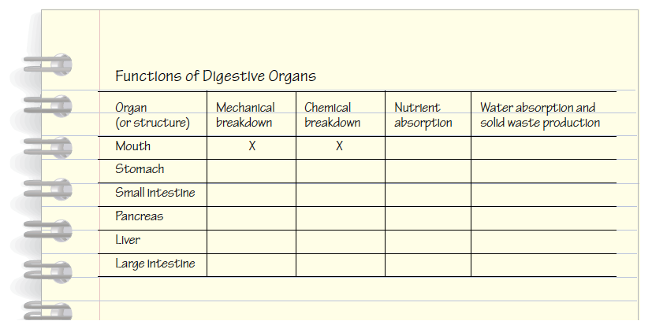
Analysis question 2
Copy the table below. Then fill in the table by placing an “X” to indicate the function(s) of each organ. The first row has been done for you.

Slide 21
Analysis question 3
Imagine taking a bite of a burrito. Follow the beans in the burrito through the process of digestion. Explain what types of changes take
place and where each change happens.

Slide 22
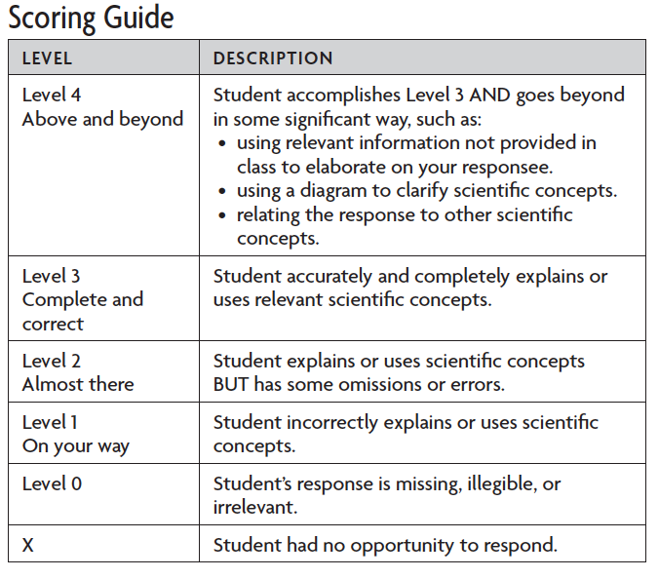
SCORING GUIDE: Understanding Concepts

Slide 23
Analysis question 4
Most substances are absorbed in the small intestine and not in the stomach. Aspirin is a common exception; it is absorbed in the stomach. Some alcohol is absorbed in the stomach, but most is absorbed in the intestine.

Slide 24
Analysis question 4
a. Why would you want medicines, like aspirin, to be absorbed in the stomach instead of the small intestine?
b. What is the effect of some alcohol being absorbed in the stomach?

Slide 25
Analysis question 5
Copy the lists of words shown below:
List 1 | List 2 | List 3
pancreas | liver | chemical breakdown
stomach | pathway for food | small intestine
esophagus | esophagus | saliva
digestive organs | stomach | teeth
heart | large intestine | pancreas
gallbladder | small intestine | liver

Slide 26
Analysis question 5
a. In each list, look for a relationship among the words. Cross out the word or phrase that does not belong.
List 1 | List 2 | List 3
pancreas | liver | chemical breakdown
stomach | pathway for food | small intestine
esophagus | esophagus | saliva
digestive organs | stomach | teeth
heart | large intestine | pancreas
gallbladder | small intestine | liver

Slide 27
Analysis question 5
b. In each list, circle the word or phrase that includes the others.
List 1 | List 2 | List 3
pancreas | liver | chemical breakdown
stomach | pathway for food | small intestine
esophagus | esophagus | saliva
digestive organs | stomach | teeth
heart | large intestine | pancreas
gallbladder | small intestine | liver

Slide 28
Analysis question 5
c. Explain how the word or phrase you circled is related to the other words on the list.
List 1 | List 2 | List 3
pancreas | liver | chemical breakdown
stomach | pathway for food | small intestine
esophagus | esophagus | saliva
digestive organs | stomach | teeth
heart | large intestine | pancreas
gallbladder | small intestine | liver

Slide 29
Analysis question 6
Take a closer look at the villi of the small intestine (part “B” in the diagram, “Cross-Section of the Small Intestine”). How do the villi help
nutrients move into the blood quickly?
Hint: What would happen if there were no villi, only a smooth surface?

Slide 30
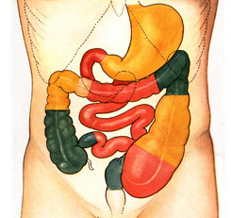
How does your digestive system work?

Slide 31
Key Vocabulary definitions
Absorb - To take in or soak up.
Absorption - The process of absorbing or being absorbed (see absorb).

Slide 32
Key Vocabulary definitions
Chemical breakdown - The breaking up of larger molecules into smaller ones through the action of chemicals (for example, hydrochloric acid, enzymes).
Cross-section - A type of representation that shows what a view would look like when cutting through an object.

Slide 33
Key Vocabulary definitions
Digestive system - An integrated system consisting of specialized organs responsible for the ingestion, digestion, and absorption of food.
Function - The specialized activities performed by a system, organ, body part, or device.

Slide 34
Key Vocabulary definitions
Mechanical breakdown - The purely physical process of breaking down larger substances into smaller pieces without changing the chemical composition of the substance.
Organ - A collection of tissues which performs a particular function or set of functions.

Slide 35
Key Vocabulary definitions
Nutrients - Chemicals that an organism takes in from its environment to use as a source of energy or in promoting growth.
Tissue - A group of similar cells and cellular material that perform a particular function.

Slide 36
Key Vocabulary definitions
Toxin - A chemical produced by one organism that is harmful to another organism.

Slide 37
Food and nutrition
To find out more about food and nutrition visit the Issues and Life Science page of the SEPUP website.
www.sepuplhs.org

