Slide 3
disease

Slide 4
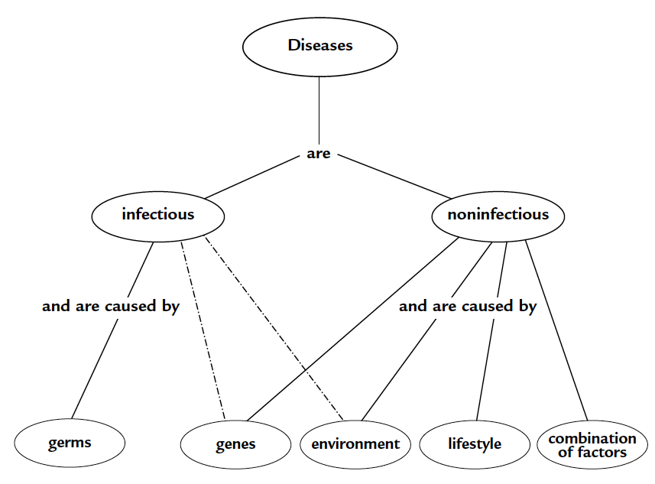
Diseases

Slide 5
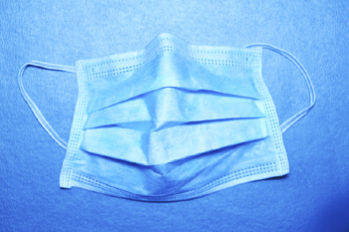
Read the introduction and look for key ideas

Slide 6
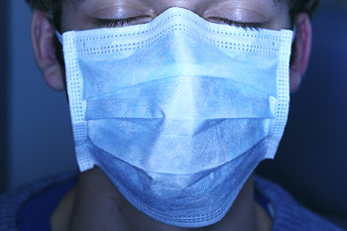
What type of information should be presented in a PSA on a disease?

Slide 7
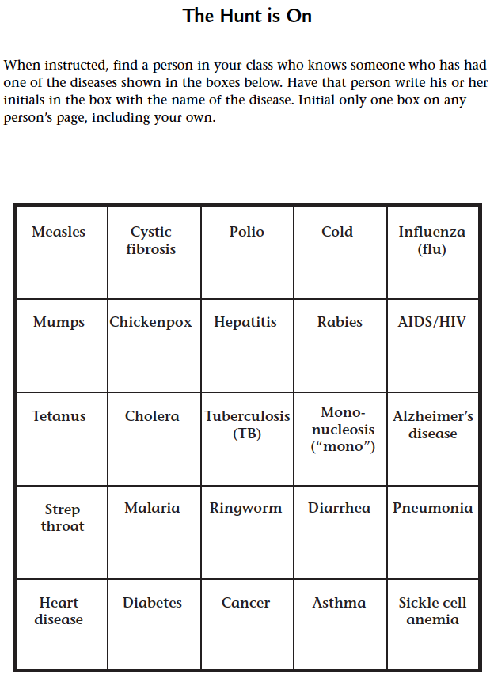
Complete procedure step 1
Complete Student Sheet 31.1, “The Hunt is On.”

Slide 8
How many students know someone who has had the flu vs. someone who has had polio?
What observations are you able to make about your familiarity with the various diseases?
Share your thoughts with the class.

Slide 9
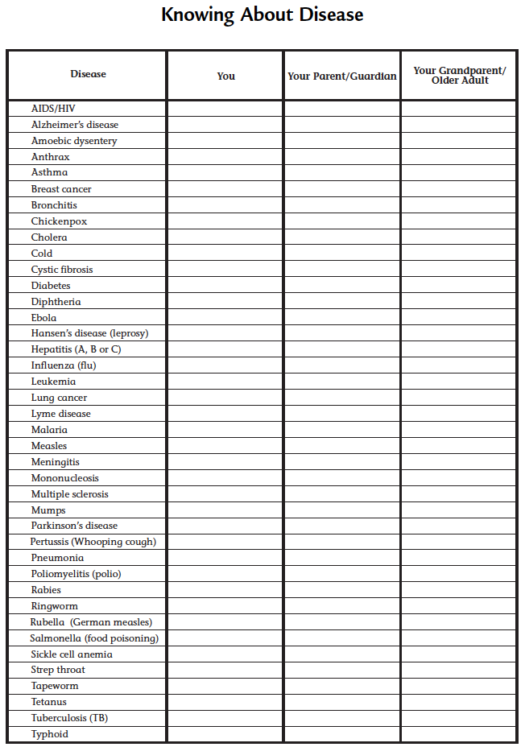
Complete procedure steps 2-4

Slide 10
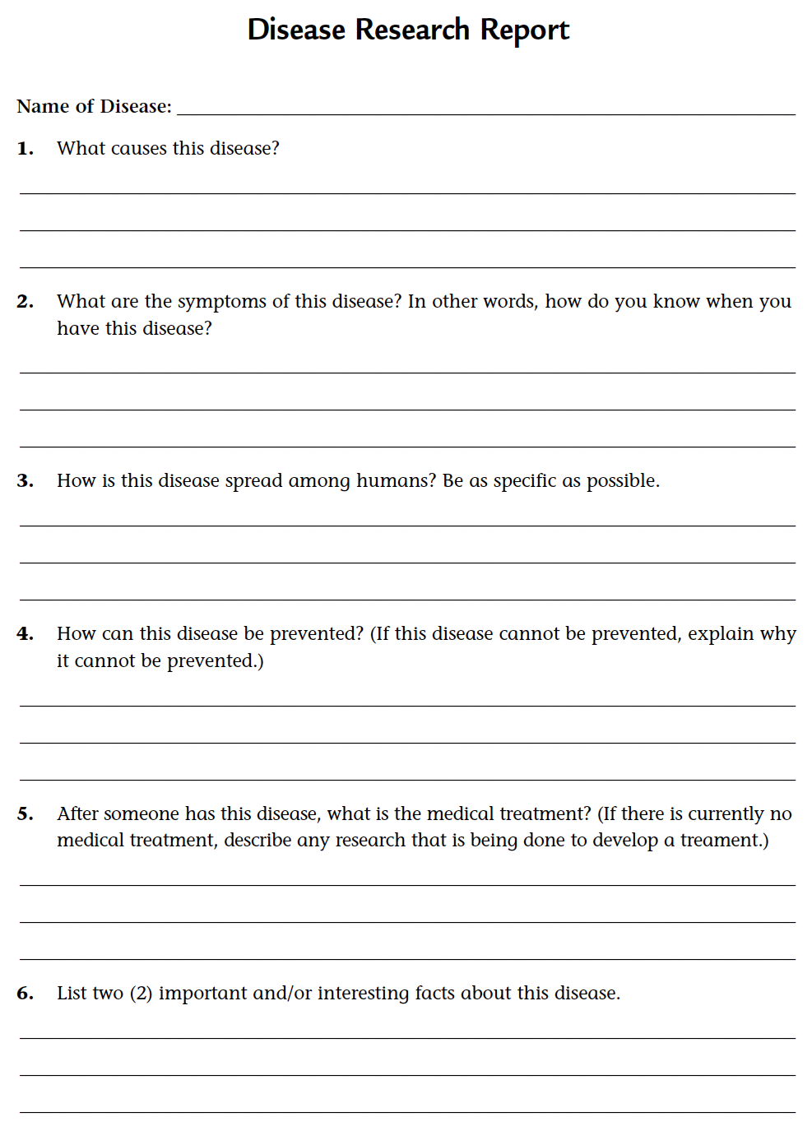
Complete steps 5-8

Slide 11
PSA panels

Slide 12
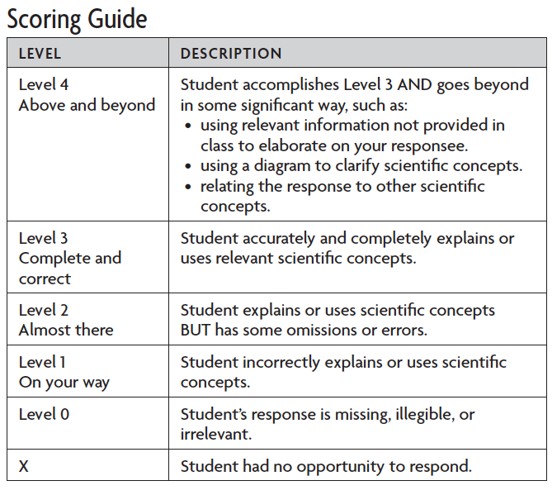
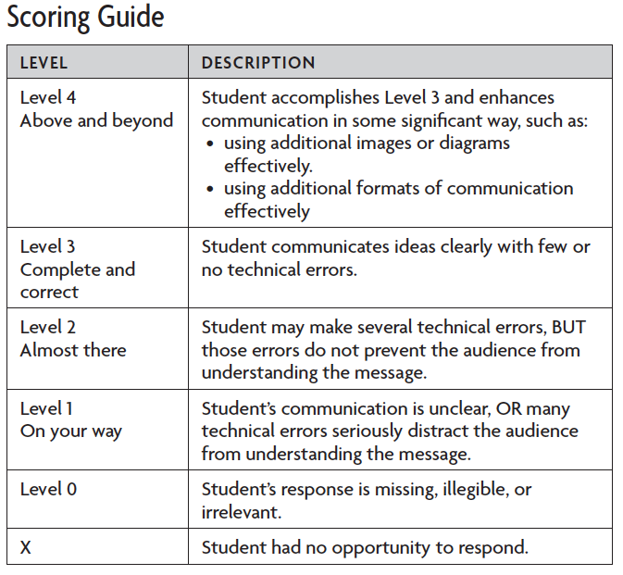
SCORING GUIDES: Understanding Concepts and Communication Skills
Understanding Concepts Communication Skills

Slide 13
Analysis question 1
For which diseases was it easy to find someone to initial your boxes on Student Sheet 31.1?

Slide 14
Analysis question 2
Would you expect to find that the same diseases are equally common in different parts of the world? Why or why not?

Slide 15
Analysis question 3
Compare the number of students, parents, and grandparents who knew someone with a particular disease. What patterns do you observe? For example, which diseases were more familiar to the grandparent generation than your generation? What do you think is the reason for this?

Slide 16
Analysis question 4
What can you do to prevent catching an infectious disease?

Slide 17
Analysis question 5
What types of diseases cannot be prevented? Explain.

Slide 18
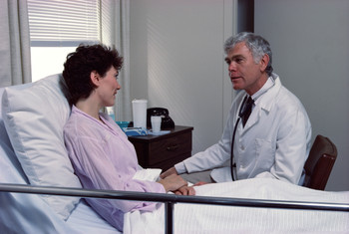
What type of information should be presented in a PSA on a disease?

Slide 19
Key vocabulary definitions
Disease - A breakdown in the structure and function of a living organism.

