Slide 1
Classification Project Gallery Walk
Period 6

Slide 2
Table of Contents
3. Monkeys
6. Whales
8. Wolves
10. Big Cats
12. Moles
15. Tropical Rainforest Birds
17. Giraffes
19. Moths
22. Squid
25. Jelly Fish
27. Frogs and Toads
31. Sharks
33. Seals
35. Mites
38. Geckos

Slide 3
Monkeys: Kendra Fisher
Common Characteristics: Some physical characteristics that all monkeys share are a tail, narrow-chested bodies, flattened nails, and short, flat faces with relatively small muzzles. They are covered in fur and have hands and feets with thumbs and big toes that are divergent from the rest of the 4 digits on each limb. Monkeys are also predominantly arboreal, meaning they primarily live in and travel through trees. Aside from their physical characteristics, they are very social creatures and when in groups, often called troops, they work together to take care of the youngest monkeys. They also enjoy playing and cuddling with one another and have very protective natures. Lastly, monkeys are known for their intelligence and adaptability, hence their large, well-developed brains, and are typically good at solving complex problems and can learn from experience as well.

Slide 4
Evolutionary Tree: On the evolutionary tree, monkeys are placed in the domain Eukarya, in the kingdom Animalia, then in the phylum Chordata, in the subphylum Vertebrata, then in the tetrapods, in the class Mammalia, in the eutherians, and in the primates, then finally to monkeys.
Number of Species: 260

Slide 5
Pygmy Marmoset Mandrill
Classification:Eukarya,Animalia, Chordata,Mammalia,Primates, Cebidae,Callithrix pygmaea
Habitat: Pygmy marmosets live in the Amazon region of Brazil, Colombia, Peru, Ecuador, and Northern Bolivia in forest trees or bamboo thickets near rivers and floodplains. They prefer living in dense rain forests as well.
Known Predators: Cats, harpy eagles, hawks, and snakes.
Diet: Pygmy marmosets are omnivores, so they eat tree sap, fruit, nectar, leaves, and small invertebrates.
Reproduction: Pygmy marmosets can be either monogamous or polyandrous depending on how many males are in the troop of up to 6 individuals. Females tend to communicate their reproductive state to males through olfactory cues and/or behavior as they do not exhibit outward signs of ovulation. Female pygmy marmosets may give birth to up to 3 offspring as well, which most frequently include fraternal twins.
Interesting Facts: Pygmy marmosets, also called pocket monkeys, little lions, or dwarf monkeys, are the smallest species of monkeys around the globe. An adult individual of the species can fit in the hand of an adult human and weighs the same as a stick of butter. They are also generally quiet, but occasionally emit clicks or high-pitched whistling sounds that serve as alarm calls.
Classification:Eukarya,Animalia,Chordata,Mammalia,Primate,Cercopithecidae,Mandrillus sphinx
Habitat: Mandrills live throughout equatorial Africa, including South-Western Cameroon, Western Gabon, Equatorial Guinea and South-Western Congo. They primarily prefer living in rainforests, thick bush, or in montane and thick secondary forests.
Known Predators: Leopards, large snakes, and birds of prey.
Diet: They are omnivores, so they eat various fruits, seeds, fungi and roots, snails, worms, frogs, lizards, and small invertebrates.
Reproduction: Mandrills are mainly polygynous where a dominant male defends a group of females to whom he has exclusive mating rights. Breeding is not seasonal but rather occurs about every two years depending on the available food supply. Females give birth to their first young between 4 and 8 years of age, where typically only a single individual is born. Twin young have only been observed in captivity.
Interesting Facts: The color patterns of mandrills are directly related to their social behavior. For example, they have bright blue and red colors on their faces which get brighter when they are excited. They also have pouches in their cheeks where they store food for snacks. Male mandrills are the largest living monkeys in the world as well and will fiercely slap the ground when angry.

Slide 6
Whales: Iman Ahmad
Place On Evolutionary Tree:As whales are part of the animal kingdom and specifically the phylum chordata (animals with vertebrae), they would be placed on the top of the left hand side of the evolutionary tree we discussed in class. Whales would be on the branch of mammals, near animals like horses and dogs.
Common Whale Characteristics: Whales breathe air through either one or two blowholes on their heads, give birth to live young, produce milk, have warm blood, move through water using a variety of fins and flippers, often travel in pods or groups, and most practice yearly migration in an effort to feed and breed.
Number Of Whale Species: Total of 90 species (76 toothed whales, 14 baleen whales)

Slide 7
The Humpback Whale The Beluga Whale
Classification: Eukarya, Animalia, Chordata, Mammalia, Cetacea, Balaenopteridae, Megaptera novaeangliae
Habitat: Humpback whales live in all oceans of the world. They are pelagic meaning they are found in open ocean waters. They travel in yearly migrations from places for feeding (cold water) to breeding (warmer water).
Predators: The few predators of humpback whales include orcas, sharks, and humans. As for the orcas and sharks, they mostly attack weaker whales (calfs, and slow or sick whales). Humans unfortunately continue to hunt and kill humpback whales for their meat and fat which is used for commercial purposes.
Diet: A humpback whales diet generally consists of krill, small fish, and plankton. They are filter feeders meaning that they take in massive gulps of ocean water and separate the water from their prey. They can eat about one and a half tons of food daily.
Reproduction: The whales become ready to reproduce when they are between five and ten years of age. During the breeding season, male humpback whales go through a series of mating rituals (physical touch, vocalization, movement of water, as well as body rolling) to attract a female. They can give birth around every 2 years and are pregnant for on average 11 months.
Interesting Facts:
Humpback whales have 2 blowholes
Humpback whale tails are unique to each individual much like the fingerprint of a human being
Humpback whales perform a hunting practice called bubble net fishing where a group of whales make a circle, blowing bubbles to push the prey into a compact ball for easy feeding
Classification: Eukarya, Animalia, Chordata, Mammalia, Cetacea, Monodontidae, Delphinapterus leucas
Habitat: Beluga whales live mostly in arctic coastal waters. A few beluga populations stay in place, but others choose to migrate. These migrations are to different feeding spots. Sometimes beluga whales can be found feeding in rivers.
Predators: Predators of the beluga whale include orcas and polar bears who hunt whales of all ages. Human’s hunt and place beluga whales in captivity and pollution of the oceans as well as global warming threaten their lives on a daily basis.
Diet: A beluga whales diet consists of many different kinds of fish, squid, and a variety of crustaceans. They are toothed whales but they mostly swallow their food in one piece.
Reproduction: The whales become ready to reproduce when they are around seven years of age. Mating occurs during warm spring months. One male is able to mate with multiple females. Mother’s are pregnant for around 15 months.
Interesting Facts:
The color of a beluga whale is an indicator of its age as the lighter the whale is the older in age (they are born a deep grey color and eventually turn fully white)
Beluga whales are able to dive down to around 3,300 feet underwater
Beluga whales are able to be underwater for about a half hour without needing to come up for breath

Slide 8
Wolves: Josie Hauck
Canidae is the biological name of a distinct family group consisting of the following members - wolves, domesticated dogs, foxes, jackals, and other wild dog-like creatures. Located on the evolutionary tree of life, all members of this family are located along the top, in the domain Eukarya, falling under the larger category of ‘Mammals.’
All members of this group share distinguishing physical canine-like features - this includes longer muzzles, pointed ears, and mouths full of sharp canines, as they are carnivores, preferring to feed on the meat of other prey animals. Most canids are about medium to large sized, with some members, such as the fox being an exception, as some may be relatively small. Canids also associate with a pack dynamic, being social animals - a most commonly thought-about example demonstrating this way of life is the wolf.
Members of the Canidae family are found to mostly reside just about everywhere around the world, except Antarctica - these animals are known to adapt to any presented environments, residing in a wide array of biomes - deserts, forests, even arctic tundra.
There are a total of 35 species within the Canidae family, 2 of which are notably extinct.

Slide 9
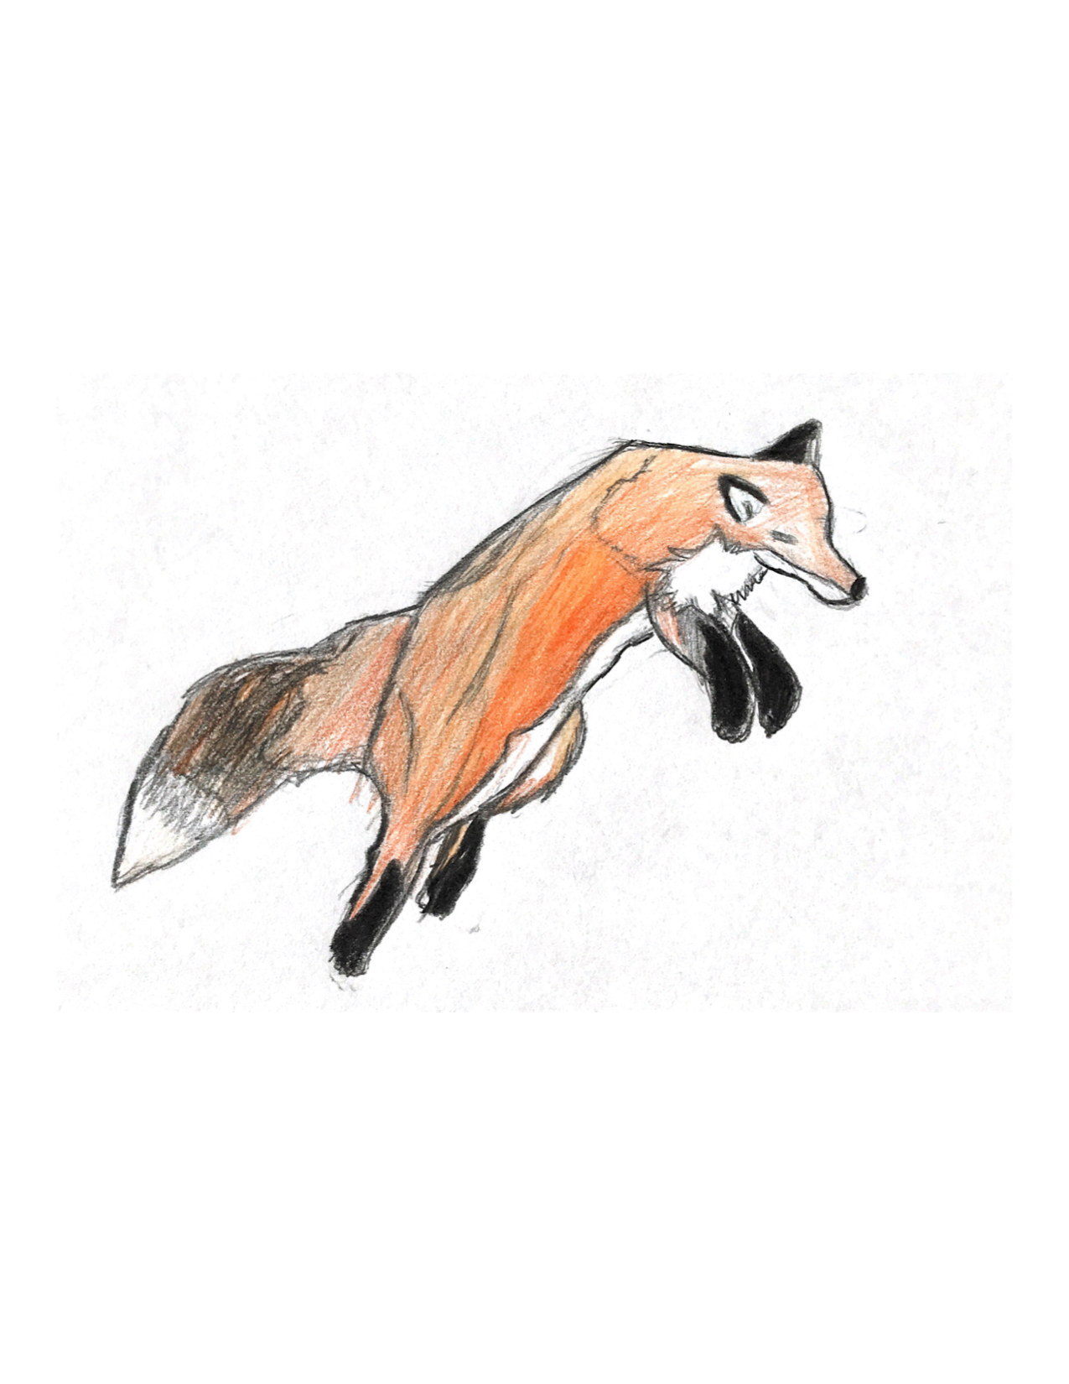
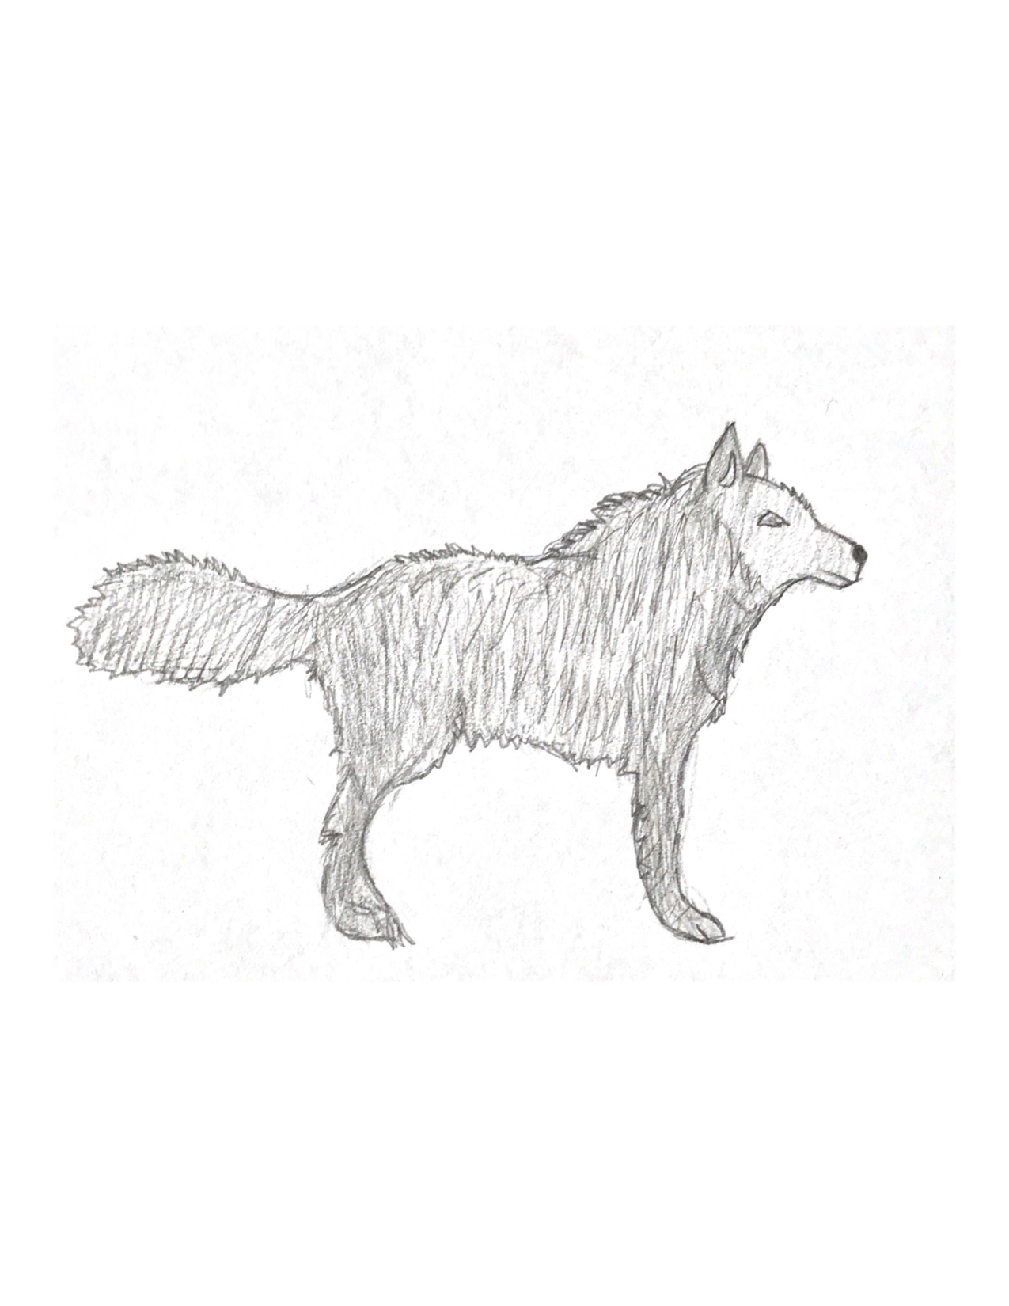
Grey Wolf Red Fox
Classification: Eukarya , Animalia, Chordata, Mammalia, Carnivora, Canidae, Canis lupus
Habitat: The adaptive grey wolf can be found thriving in mountainous terrain, coniferous forests, open prairies and woods - typically anywhere abundant in prey resources.
Predators and Diet: The wolf is a priority apex predator, so it has few predators - however, the wolf has many natural enemies it is in constant competition over resources with - these include grizzly bears, mountain lions, and coyotes being the most prominent. Most encounters with these animals end in fatalities on either side. Humans are another danger to wolves. The grey wolf is a strict carnivore - within its established territory the wolf is capable of bringing down larger game, such as moose, elk, deer and bison if it has a strong pack. Smaller prey animals, like lemmings, mice, rabbits and voles also make up a wolf’s diet and is more priority for a disadvantaged lone-wolf.
Reproduction: Wolves mate for life. In a pack, only the alpha male and female are permitted to mate, and bear a litter annually every spring. Litters consist of about 4-6 pups. Younger wolves at sexual maturity, usually aged 2, set out to leave their family packs becoming lone wolves in search of a compatible mate to form their own packs
Interesting Facts:
The phrase, the “wolf howls at the moon” is not literal, as howling is instead used as a means of communication between an established family pack, and outsiders.
Wolves are highly territorial animals, as they live and hunt within a claimed area of land (often between 50-1000 square miles.)
Wolves were absent from Yellowstone National Park in Wyoming beginning in 1926, until 1995 when a highly-successful wolf reintegration program began, jumpstarting the wolf population. Today there are about 94 wolves composed of 8 packs pulled from records as of January, 2020.
Classification: Eukarya, Animalia, Chordata, Mammalia, Carnivora, Caned, Vulpes vulpes
Habitat: The red fox is found throughout the United States, as it is native to North America. The red fox is also present in other areas of the Northern Hemisphere (Europe, Asia). The red fox lives in a multitude of habitats, these being heavily-forested areas, open woods - foxes may even settle in a more suburban area.
Predators and Diet: Foxes are a significantly smaller member of the Canidae family, thus they are more at risk for predation. Foxes fall victim to wolves, coyotes, mountain lions, lynxes, eagles, owls and grizzly bears who kill for competition, and sometimes food. fox’s diet consists of small rodents (mice, lemmings) rabbits, small birds, frogs, even fruit.
Reproduction: Red foxes mate during the wintertime, and the parents live together in a den in preparation for kits. Red fox litters consist of between 1-12 kits. Kits are taken care of by the parents, until they are old enough to set off alone.
Interesting Facts:
The fox group as a whole is one of the only members of the Canidae family that do not demonstrate social pack behavior, as compared to other members composed of a strong pack dynamic.
Foxes are capable of detecting prey underground in low-frequencies, having a fantastic sense of hearing - this is what makes them great predators especially in the winter.

Slide 10
Big Cats: Owen Okuley
Evolutionary Tree: In the evolutionary tree, the big cats belong to the Animalia Kingdom, in the Mammalia Class, thereby placing them in the upper left corner of the tree of life as seen in class
Big Cat Characteristics: While clearly larger in size than the housecats in our homes, the big cat family has more differentiating qualities than just their massive size. Along with their imposing stature, big cats are classified as such given their unique ability to produce a roar. This is because a specially designed larynx that enables the bass present within their roars. This is why the snow leopard's move to the Panthera genus in 2008 is considered highly controversial, as the snow leopard is unable to produce a roar, and why the cheetah and cougar are excluded altogether. Unfortunately, all four major big cats (Tigers, Lions, Leopards, are classified as endangered, with multiple subspecies becoming critically endangered or extinct altogether.
Number of Species: 38
Recently Extinct Species: 8?

Slide 11
Tiger Lion
Classification: Eukarya, Animalia, Chordata, Mammalia, Carnivora, Felidae, Panthera tigris
Habitiat: Tigers inhabit large portions of eastern and southern Asia, and are highly adaptable creatures, roaming through large grasslands, jungles and swamps.
Known predators: No known predators
Diet: Tigers are carnivores. In the wild they may eat 10-25lbs of prey per day, however on certain occasions, tigers may consume up to 100lbs of prey and fast for several days.
Reproduction: Tigers reach sexual maturity around age 3 for females and 5 for males. During the months between November and April, tigers tend to copulate far more frequently, and produce young 3 months after conception
Interesting facts: The unique stripe pattern on tigers acts in a way similar to human fingerprints and snowflakes, with each tiger having its own, completely unique pattern of stripes. They are also the third largest carnivore on land, only behind polar and brown bears. Unlike other big cats, tigers tend to be powerful swimmers, and can hunt in the water as well as on land.
Classification: Eukarya, Animalia, Chordata, Mammalia, Carnivora, Felidae, Panthera leo
Habitat: The lion inhabits a portion of sub-saharan Africa, preferring to live in open woodlands, scrubs, and grasslands
Known predators: No known predators
Diet: Lions are carnivorous creatures, with their diet ranging from antelope to elephants depending on the hunt of the day. They typically eat 17-20lbs of meat daily, however this total can increase to 100lbs if the lion has not eaten recently.
Reproduction: While both sexes are polygamous and breed throughout the year, each individual female will be receptive to mating for three to five days in a widely variable breeding cycle, during which they mate once every thirty minutes, resulting in 50 copulations per day. They will carry no more than one litter every two years.
Interesting facts: Unlike other big cats, lions are a social animal that lives and hunts in groups. Within these groups, the females are the primary hunters, while the males take more of a leadership role. The distinctive mane of the male lions is vastly important within the social hierarchy, as a lion with a darker, longer mane, will generally attempt to usurp the pride from the control of another.

Slide 12
Moles: Tucker Davis
Common Characteristics of Moles: Moles have stocky, cylindrical shaped bodies, covered by velvety fur. They typically have tiny eyes that barely work, a long pink nose and two large front paws that function as shovels.
Number of Species of Moles: 20
Moles place in the evolutionary tree: Moles closest evolutionary relative is the shrew, and they all belong in the group of insectivores which consists of hedgehogs, shrews, and moonrats. Further down the evolutionary tree belongs the rodent family that moles evolved from. Way further down the evolutionary tree the mole family belongs to the same section of elephants, marsupials, manatees, and aardvarks.

Slide 13
Star-nosed Mole
Classification: Eukarya, Animalia, Chordata, Mammalia, Soricamorpha, Talpidae, Condylura
Habitat: Star-Nosed Moles typically live in forests, marshes, peat land and banks of ponds and streams, typically places with moist soil or poor drainage. They are native to Eastern North America and also found in the Appalachian Mountains.
Known Predators: A Star Nosed Moles known predators include barn, long eared, great horned and barred owls, red tailed hawks, skunks, minks, weasels, foxes and fish like the northern pike.
Diet: Star nosed moles are carnivores that eat invertebrates like beetle larvae and earthworms. Their main diet consists of aquatic organisms like mollusks, crustacea, small amphibians and sometimes fish.
Reproduction: The reproduction habits of moles aren't super well known but what is known is that females bear one little of 2-7 pups between April and early July. The gestation period is 45 days and the pups are born pink and hairless. They typically leave the nest around 21 days and then sexual maturity begins in the next spring.
Interesting Facts:
The way the species interact and communicate with each other is a mystery as they dont have strong ears or eyes to hear or see each other, the only known communication is through smell of glands which was described to be exceedingly rank and nauseous
The tentacles around their nose are retractable and aren't used for smelling but feeling around the tunnels
The tentacle around their nose is known to be the most sensitive external organ of any mammal
Star Nosed Moles are functionally blind

Slide 14
Eastern Mole
Classification: Eukarya, Animalia, Chordata, Mammalia, Soricamorpha, Talpidae, Scalopus Aquaticus
Habitat: Eastern Moles are known to be native to the Nearctic Region, more specifically southeastern Wyoming, South Dakota and central Texas to east Michigan. They live in fields, meadows and open pastures with moist soil.
Known Predators: The eastern mole is not preyed on often because of their underground lives and odor but when they are preyed on its typically by snakes owls and foxes, mainly organisms that prey on small rodents
Diet: Eastern moles are carnivores that eat earthworms, insects and their larvae, and vegetation.
Reproduction: Eastern Moles mate February to March and their gestation period is 45 days. Then in the later spring the female typically gives birth to 2-5 pups in a litter. They’re born pink, naked and blind then around 4 weeks they leave their nest and begin to forage for themselves. Their typical lifespan is around 36 months maximum.
Interesting Facts:
They can dig up to 20yards in a day
They can move just as fast backwards as they can forwards and they’re good swimmers
Although they are relatively blind they can sense when light is or isn't present
Moles spend 99% of their time underground

Slide 15
Tropical Rainforest Birds: Kyla Reynolds
Place on the Evolutionary Tree: The closest relative to tropical birds like the parrot are passerines, otherwise known as song birds. Before that, they evolved from falcons. The three types of birds belong to a clade called Australaves. Toucans are closely related to barbets, and are relatives of the woodpecker. Toucans and parrots are actually not very closely related, but have similar features because they live in the same niche (tropical rainforest) and therefore evolved similarly.
Common Characteristics: Some common characteristics of tropical birds are colorful feathers, curved beaks, strong beaks, and two toes pointing forwards and two pointing backwards (zygodactyl feet).
Number of Species: There’s over 5,000 species of tropical birds.

Slide 16
Scarlet Macaw Keel-Billed Toucan
Classification: Eukarya, Animalia, Chordata, Aves, Psittacoidea, Psittacidae, Ara macao
Habitat: The Scarlet Macaw can be found in Mexico, Guatemala, Belize, Colombia, Ecuador, Amazonian Peru and Brazil. It lives in the tall deciduous trees near water.
Known predators: Their natural predators include monkeys, jaguars, hawks, eagles and snakes.
Diet: The majority of their diet includes nuts, seeds, berries, leaves, and fruit.
Reproduction: Scarlet Macaws form monogamous bonds for life with another bird, and mating occurs every one or two years. The females will have 2-4 eggs and incubate them for 24-25 days before they hatch. The males rarely help incubate the eggs.
Interesting Facts: They are the largest parrot in the world, with a wingspan of over 3 feet. It can also eat some fruits that are toxic to other animals. This is most likely because they eat a lot of clay from riverbanks, which neutralizes the poison in the plants.
Classification: Eukarya, Animalia, Chordata, Aves, Piciformes, Ramphastidae, Ramphastos sulfuratus
Habitat: The keel billed toucan can be found in Southern Mexico, Venezuela, and Columbia. It lives in the canopies in tropical, subtropical, and lowland rainforests, often in holes in the trees with other toucans.
Known predators: Large birds of prey and humans are threats to the birds, while weasels, snakes, and other birds are threats to their eggs.
Diet: A variety of fruits, insects, eggs, and lizards are the main components of their diet.
Reproduction: The females will lay 1-4 eggs in a tree cavity, and the males and females switch off taking care of the eggs while incubating. They hatch 15-20 days after they’re laid.
Interesting Facts: These birds are very playful, and travel in large groups of around 15. They throw fruit into the beaks of other birds as well as play fight.

Slide 17
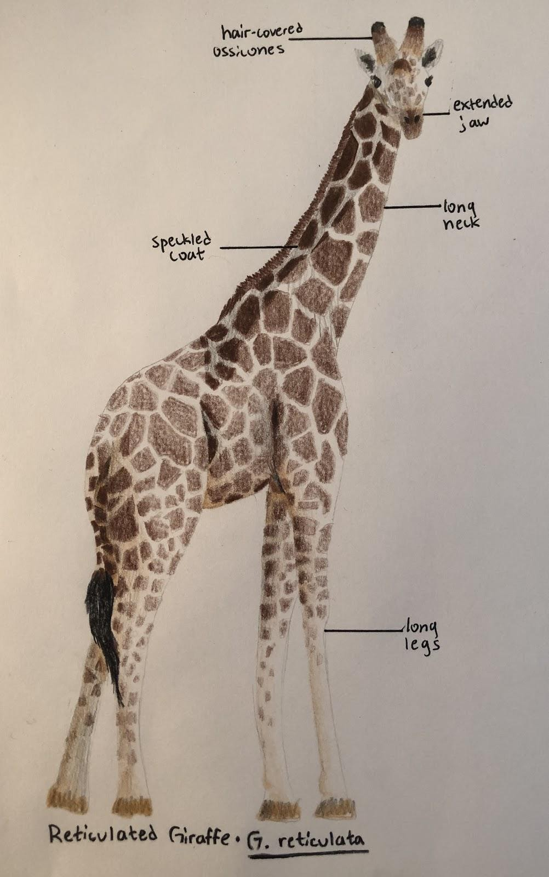
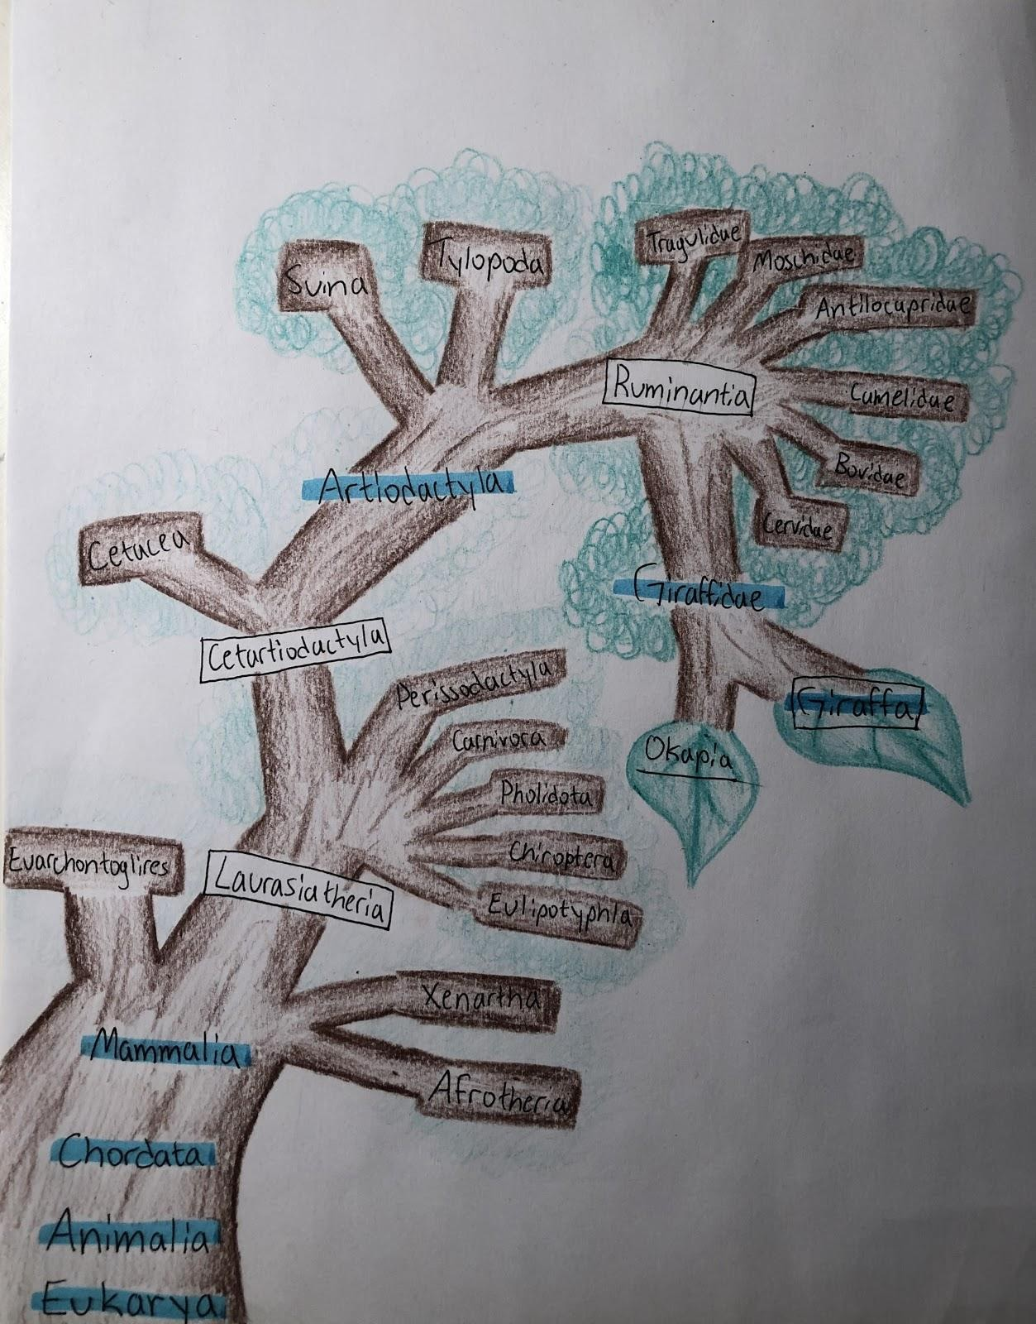
Giraffes: Sydney Huard
Species: The number of giraffe species is a very new topic in terms of taxonomy research. The neweststudy suggests that there are three species (Northern, Southern, and Masai) and a total of ninesubspecies. However, the IUCN has yet to recognize this information and officially lists thegiraffe as one species with nine subspecies.
Common Characteristics: Giraffes are mammals, known for their extremely long necks and speckled pattern. They may beas short as 14 feet or as tall as 20 feet. As herbivores, they use their long necks and tongues tofeed off tree leaves. They have extended jaws and hair-covered ossicones.

Slide 18
Masai Giraffe Southern Giraffe
Classification: Eukarya, Animalia, Chordata, Mammalia, Artiodactyla, Giraffidae, Giraffa, camelopardalis, tippelskirchi
Habitat: Savannah biomes in Kenya, Ethiopia, Somalia, and Tanzania
Known Predators: Lions and Hyenas are natural predators, but Masai Giraffes are main targets for poachers.
Diet: Leaves, twigs, and bark from Whistling Thorn Acacia trees.
Reproduction: Masai Giraffes of four years or older will breed all year round. Mother giraffes carry calves for 14 to 15 months before birthing six-foot tall babies.
Fun facts: With 1½ foot long tongues, Masai Giraffes eat leaves by reaching behind the thorns on Acacia trees. They can be distinguished from other species of Giraffe by their jagged spots and the faded spots on their legs. They can run at speeds up to 35 miles per hour.
Classification: Eukarya, Animalia, Chordata, Mammalia, Artiodactyla, Giraffidae, Giraffa, camelopardalis, giraffa
Habitat: Savannah and Forest biomes in South Africa, Namibia, Zambia, Botswana, and Zimbabwe.
Known Predators: Leopards, Hyenas, and other wild dogs are their main predators, but occasionally crocodiles will attack Southern Giraffes at watering holes.
Diet: Primarily leaves of Acacia trees, but occasionally hibiscus and lilies.
Reproduction: Southern Giraffes have exactly the same reproduction process as Masai Giraffes, with no breeding season, 14 to 15 month pregnancy, and giraffes being able to mate at four years old.
Fun Facts: In order to establish dominance, male giraffes battle each other with their necks, a process called “necking.” They can be distinguished from other species of Giraffe by their lack of faded color and pattern on their legs. Giraffes spend 16-20 hours per day feeding.

Slide 19
Moths: Hilario Gonzalez
Common Characteristics: Among moths there is a lot of variation; they live everywhere in the world (except for in polar environments) and they come in a wide range of sizes and every color you can think of. However, all moths do have the same number of wings: two forewings, and two hindwings. Also, all moths are covered in dusty flaky scales that can come off when the moth is touched. Moths tend to be more thick and fuzzy than butterflies, with wider feathery antennae. All moths have four stages in their life cycles: egg, larvae, chrysalis, and adult.
Species: There are approximately 160,000 moth species with around 20 recently extinct.

Slide 21
Death’s Head Hawkmoth Atlas Moth
Classification: Eukaryote, Animalia, Insecta, Lepidoptera, Sphingidae, Acherontia, atropos
They live across the majority of Africa, the middle east, parts of India, and now up through Europe into Britain as a result of increasingly milder winters.
Predators are bats and birds
They eat flower nectar and steal honey from honeybees
They reproduce by laying eggs, and after procreating the adult moths soon die.
It got its name from the interesting skull shaped pattern on its back.
I picked it because of the Silence of the Lamb movie
Classification: Eukaryote, Animalia, Insecta, Lepidoptera, Saturniidae, Attacus, atlas
They live in dry tropical forests and shrublands across southeast Asia
Small mammals and birds will eat them if they’re not scared off by their bold patterns, bright colors, and snake head shaped wing tips.
Larvae will eat their eggshell as their first meal and then the leaves of whatever tree they hatched on until they’re ready to weave their cocoon. Adults don’t have mouths, so they don’t eat anything, they exist solely to reproduce.
Because they don’t eat, an adult Atlas moth will die very quickly, and any form of flight costs them more energy which only shortens their lifespan. Because of this, females will emerge from their cocoon and find the nearest place to sit and wait for a male to approach so it can fertilize and then lay its eggs.
This is known as the largest moth species in the world with a wingspan of 10 inches and a surface area of 25 inches squared. This is a larger wingspan than the northern cardinal which is crazy to me.

Slide 22
Squid: Jordan Hornick
The common characteristics of squids are their 8 arms and 2 tentacles, along with hooks in their suckers or sucker rings. Additionally, all squid move by jet propulsion, and have a siphon that comes out of their mantle to stream water out. All squids have mouths with radullas, which are beaks for scraping and cutting up their food. All cephalopods happen to be carnivorous, so this beak is used for shrimp, small fish, and other squid. They also all have triangle shaped mantles with two head fins to help guide them through water as they move.

Slide 23
There are over 300 separate species of squid that are known. Some notable species are the colossal and giant squids, which are the largest of the known squid species. Giant squids can be over 50 feet long from mantle to tentacle tip, while colossal squids can weigh over 1100 pounds. The two species are extremely rare, due to the extreme depths at which they live. The high pressure per square inch of the ocean at these depths is what allows these squids to grow to this size. Another notable species is the Humboldt squid, which can get to the size of about 6 feet and 110 pounds. Also called jumbo squid, they are nicknamed “red devils” by fisherman in the eastern Pacific Ocean, as they are known for attacking and mutilating humans. A final notable squid species is the vampire squid, which live at depths similar to that of giant and colossal squids. They are technically not classified as a squid or octopus, rather their own category of cephalopod. They are known for their rarity and creepy/ominous look, and their uniqueness in comparison to other cephalopods.

Slide 24
Classification
Giant Squid: Eukarya, Mollusca, Cephalopoda, Coleoidea, Teuthida, Architeuthidae, Architeuthis, Architeuthis dux
Humboldt Squid: Eukarya, Animalia, Mollusca, Cephalopoda, Teuthida, Oegopsida, Ommastrephidae, Docidicus, Docidicus gigas
Habitat
Giant Squid: Extreme deep sea, near continental shelves and slopes leading up to land all over the world
Humboldt Squid: All along the western coast of the Americas, at depths of up to 2300 feet.
Predators
Giant Squid: Due to their size, almost nothing except for sperm whales and possibly other giant squid
Humboldt Squid: Tuna, billfish, carnivorous sharks
Diet
Giant Squid: Fish, shrimp, other squid, possibly small whales
Humboldt Squid: Fish, crustaceans, shrimp, and anything else that moves (including humans)
Reproduction
Giant/Humboldt Squid: Sperm is stored in a special sac, and a designated arm moves “handfuls” of the sperm into a female’s egg sac near her mantle or beak during mating
Interesting facts
Giant Squid: Only 3 videos have ever been captured of giant squid in real life, and there is very little known about them besides the fact that they are one of the oceans’ largest remaining organisms
Humboldt Squid: Tend to be extremely aggressive, and are nicknamed red devils because they dart around and flash red and white rapidly before attacking. They are by far the most dangerous species of squid, maybe even cephalopod.

Slide 25
Jelly Fish: Michaela Chen
Place in the evolutionary tree: Jellyfish come after sponges and before mollusks on the evolutionary tree. Jellyfish have organs which separates them from sponges. But they don’t have nerves and vascular systems which makes them different from mollusks.
Common Characteristics:
No brain, heart, or bones
Have tentacles with stinging cells that are used to stun or paralyze prey
Their mouth is found at the center of their body where it both eats and discards waste
Jellyfish use their mouth to squirt a jet of water which propels them forward
Digest food quickly so they aren’t weighed down
Number of Species: 2000

Slide 26
Sea Wasp Moon Jelly
Classification: Eukarya, animalia, cnidaria, cubozoa, chirodropida, chirodropidae, chironex, fleckeri
Habitat: Sea wasps are found in the coastal waters off of Western Australia and in the Indo-pacific.
Predators: There are very few predators because of its venom; however some sea turtles like the green sea turtle are able to eat the sea wasp.
Diet: Sea wasps are carnivores that use their tentacles to kill prey like small fish, crabs, and shrimp.
Reproduction: Sexually mature females release eggs while males release sperm into the ocean so the eggs can be fertilized and develop in the open water
Interesting Facts: Sea wasps are one of the most venomous creatures in the world, they have 24 eyes along their bell (but without a central nervous system, scientists aren’t sure how they see), and they have barbs on their tentacles called nematocysts which store venom.
Classification: Eukarya, animalia, cnidaria, scyphozoa, semaeostomeae, ulmaridae, Aurelia, aurita
Habitat: Moon jellyfish are found near the coasts in the Atlantic, Pacific, and Indian oceans, usually in warm waters.
Known Predators: Fish and sea turtles
Diet: Moon jellies feed on organisms such as crustaceans, mollusks, and protozoans.
Reproduction: Like the sea wasp, moon jellies release sperm and eggs into the water where the eggs are fertilized and develop in the open water.
Interesting Facts: Moon jellyfish travel in groups called smacks, they only have a very mild sting, and are 95% water.

Slide 27
Frogs and Toads: Naseem Sarkez

Slide 28
Species: 580 species of Toads
Common Characteristics of Toads:
Toads live on land near water
No Teeth
Toads have Bidder’s Organ in both sexes that Frogs lack
Toads have bufotoxins behind their eyes that secretes poison
Dry bumpy skin, lots of warts and crests throughout the body
Common brown or green skin for camoflouge
Puff up body to look larger against predators
Species: 600 species of Frogs
Common Characteristics of Frogs:
Frogs live in mostly aquatic areas
Frogs have teeth
Typically longer than toads
Smooth silky skin
Common brown or green skin for camoflouge
No tail
Protruding eyes
Webbed feet for swimming and leaping

Slide 29
Marine Toad
Classification: Eukarya, Animalia, Chordata, Amphibia, Anura, Bufonidae, Bufo marinus
Habitat: Marine toads are native to Central and South America, and can be found in Australia, Hawaii, Philippines, Puerto Rico, and South Florida. Marine toads live near areas with a source of water such as canals and ponds.
Known Predators: Snakes and spiders, dogs, and birds are predators of the marine toad. Other predators that might threat the eggs of marine toads include aquatic insects, fish, birds, and humans.
Diet: Marine toads eat insects, lizards, mamals, birds, mamals, plants on occation
Reproduction: Female marine toads can produce up to 40,000 eggs, where regardless of the level of predation, there’s a high chance for some young are still expected to be alive. It takes 2 to four years for a marine toad to be able to reproduce.
Interesting facts:
Marine toads eating plant matter in adulthood distinguishes them from most Amphibians
The posions the marine toad carries acts as a defense mechanism to small-medium size animals.

Slide 30
North American Bullfrog
Classification: Eukarya, Animalia, Chordata, Amphibia, Anura, Ranidae, Rana Catesbeiana
Habitat: Found predominantly from central to eastcoast of North America, but can also be found in Novia Scotia, Mexico, and Cuba. Bullfrogs live along the edge of slow bodies of freshwater such as ponds, swamps, and lakes.
Known Predators: Aquatic insects, crayfish, other bullfrogs, aquatic turtles, snakes, birds (herons, egrets, kingfishers), and humans.
Diet: North American Bullfrogs have a wide range of what it eats, as it will eat mamals, birds, reptiles, fish, turtules, and other frogs.
Reproduction: Female North American bullfrogs can lay up to 25,000 eggs and are stored at the surface of the water. It takes 2 to four years for a North American bullfrog to be able to reproduce.
Intresting facts:
Despite being underwater, North American bullfrogs can absorb oxygen through their skin.
Since territory ownership is a major role in attraction, bullfrogs protect their territory by calls, wrestling, chases, and jump attatcks.

Slide 31
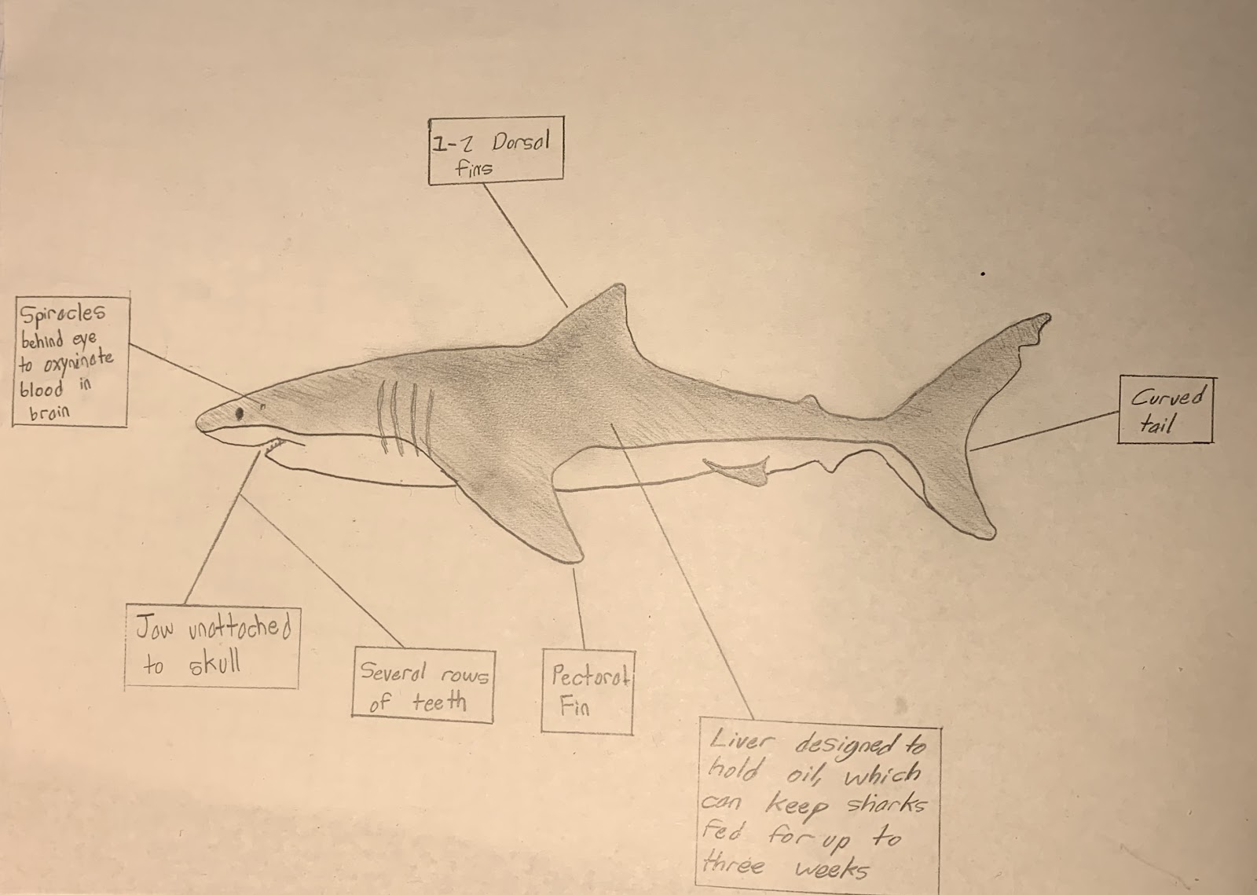
Sharks: Cole Fettkether
Characteristics of sharks
Skeletons made of cartilage
Jaws disconnected from skull
Multiple rows of sharp teeth
Denticles as skin
Pectoral fin
1-2 dorsal fins
Gills
Spiracles behind eyes
Scientists believe that sharks evolved from jawless fish known as ostracoderms, about 400-450 million years ago. From fossils, scientists have found scales that are similar to sharks today, but all fossils lack teeth, suggesting that sharks could have been without teeth at one time. Analysis of fossils leads scientists to believe that sharks diverged from Chimeras and Rays about 420 million years ago. By 410 million years ago, sharks were showing the first signs of having teeth. By 380 million years ago, the first shark that looks like sharks today evolved, the Cladoselache. After a mass extinction about 360 million years ago, sharks became much more dominant, as much of their competition had died off. During the age of the dinosaurs, sharks began to shrink slightly and gained detachable jaws allowing them to consume larger prey. By 66 million years ago, sharks began to grow in size again, and modern age sharks like the great white and hammerhead were evolving. Throughout their 450 million years of life, sharks managed to live through five mass extinctions.
Around 440 species

Slide 32
Great White Shark Tiger Shark
Eukarya - Animalia - Chordata - Chondrichthyes - Lamniformes - Lamnidae - Carcharodon - carcharias
All oceans surrounding land except for the Indian Ocean
Humans, sometimes orcas
Large fish, seals, rays, sea lions, and small whales
Great white sharks are ovoviviparous, which means an egg grows inside the mother, and a shark put is born
Small holes around the snouts of great white sharks called the Ampullae of Lorenzini are able to detect slight electrical currents in the water
Eukarya - Animalia - Chordata - Elasmobranchii - Carcharhiniformes - Carcharhinidae - Galeocerdo - cuvier
In warmer oceans, close to coastlines
Humans
Crustaceans, fish, other sharks, turtles, birds, squids, seals, and snakes
Tiger sharks mate through internal fertilization
Tiger sharks have the widest diet of any shark

Slide 33
Seals: Sofia Dominic
Physical Characteristics:
Coat Color: can range from a light grey to a dark charcoal depending on the location of the seal.
Size: Males-154-375lbs Females-110-331lbs
1.1-21 feet long
Body Type: Seals have round heads with body’s that taper towards its tail. They have flippers for limbs with blunt claws. They have a short flat tail and whiskers.
Web footed aquatic mammals.
Majority live in cold seas.
There are two types of seals:
Earless or true seal- Phocidae
Eared Seals- Otariidae
There are 32 species of seals today.
Evolutionary Tree:
Seals have evolved from walking land animals shocking enough. They were carnivorous and had sturdy legs. Looks like a seal with legs, an otter type of body.
A fossil they call Puijila can show the true ancestor of the seal. It was found on Devon Island in Canada and is believed to be 20-24 million years old.

Slide 34
Harp Seal Leopard Seal
Classification: Eukarya, Animalia, Chordata, Mammalia, Carnivora, Pinnipedia, Phocidae, Pagophilus groenlandicus
Habitat: They live in Northern Atlantic and Arctic Oceans and spend most of their time on land. They are also semi-aquatic marine animals.
Known Predators: Polar Bears, Orca, Sharks and Walruses.
Diet: Anything available like cod herring, fish in general, shrimp krill prawns,
Reproduction: Pretty independent animals. Heardship only for reproduction in water. Gestation time of 4.5 months. They give birth on pack ice then leave the pup for 6-8 weeks until it melts
Interesting Facts: Can grow up to 6 feet long and be 400 pounds. Pups teeth grow when eaten and no other time. They can distinguish babies based on smell.
Classification: Eukarya, Animalia, Chordata, Mammalia, Carnivora, Phocidae, Monachinae, Hydrurga lyptonyx
Habitat: They hunt and live in Antarctic Waters. They stay on pack ice for the majority of their lives.
Known Predators: killer whales, otherwise one of the top predators of antarctica.
Diet: They hunt penguins, krill, fish squid and small seals.
Reproduction: They are solitary animals. Male and female seals sing during mating times. Females have a gestation time of 11 months. Father does not help with the raising.
Interesting Facts: They can camouflage underwater using countershading which means they have a lighter colored stomach and a darker back making it difficult to spot them underwater.

Slide 35
Mites: Susanna Arambula
Common Characteristics:
Their body is made up of a cephalothorax (the front part)and an opisthosoma (the “rear”), with no separate head
Most mites are less than 1mm
One to four eyes, or blind with no eyes
Usually four pairs of legs, each with six segments
A gnasthoma, making a retractable second segment of their body, which contains the feeding parts including the palps, chelicerae, and hypostome
Sometimes they have setae, which are hair-like structures and their use varies between species
A central ganglion, which is their equivalent of a brain, and is a group of neuron cell bodies
Bilateral symmetry

Slide 36
Evolutionary Tree: Mites lie in the domain Eukaryota, meaning that they are multicellular organisms with membrane bound organelles. As far as we know, this domain arose between 1.5 and 3 billion years ago from prokaryotes. Mites lie within the Eukaryotic kingdom Animalia, meaning that they are not plants, fungi, or protists. Animalia originated about 600 million years ago. Plants originated about 1000 million years ago, fungi arose about a thousand million years ago, and protists evolved about 1.8 billion years ago, though it’s hard to pin down because their fossils are not well preserved. It is currently suspected that animals, along with fungi and plants evolved from protists. Within the kingdom Animalia, they lie in the phylum of Arthropods, meaning that they have chitinous exoskeletons, and segmented bodies. They lie in the class Arachnida, meaning that they have eight legs and a body segmented into two main parts. They then lie within the subclass Acari. Mites are currently estimated to be between 60 and 400 million years old.
Species: The current estimate is that there are at least 48,000 species of mites today. However, some scientists believe there to be up to a million species. They are extremely diverse and live in almost every habitat imaginable, even underwater.

Slide 37
VARROA DESTRUCTOR TYROPHAGUS CASEI
Classification: Eukaryota, Animalia, Arthropoda, Arachnida, Parisitformes, Varroidae, Varroa destructor
Habitat: They live on bees all around the world
Known predators: Pseudoscorpions, Tropilaelaps
Diet: Feeds on the honey bees Apis cerana and Apis mellifera. Attaches to the body of the bee and sucks its fat bodies until it dies
Reproduction: It can only reproduce in a honey bee colony. They lay eggs on top of the bee’s eggs, and then both the bee’s eggs and their eggs hatch at about the same time. For more info about general mite reproduction, see Tyrophagus casei.
Interesting facts: They are the parasite that has the largest impact on the beekeeping industry. It’s a vector for at least five fatal bee viruses
Classification: Eukaryota, Animalia, Arthropoda, Arachnida, Sarcoptiformes, Acaridae, Tyrophagus casei
Habitat: They can live on cheese. They also live wherever there’s food (see diet)
Known predators:
Diet: cheese, corn, flour, old honeycomb, parts of birds, meat/ apparently they eat smoked meat! (sounds like a yummy diet to me)
Reproduction: I had a hard time finding out about their reproduction specifically, but generally, mite reproduction works by: males having a pair of testes and females a single ovary, located in the mid-region of the body. They both have a gonopore. In females, the gonopore is the opening of the oviduct, and in males it is the ejaculatory duct. All invertibrates have a gonopore. They have eggs which after up to six weeks hatch into larva, which turn into nymphs after three moults, which turn into adults after three more moults.
Interesting facts: They are also called “cheese mites” and are sometimes used to make German cheese. They defecate on the cheese and shed their skin on it, and some people like the flavor that gives it (ew) In the early 1900s, they were featured in one of the earliest science documentaries, and it inspired a bunch of people to buy light microscopes

Slide 38
Geckos: Ikasha Lowe
Common Characteristics: Physical characteristics of geckos are that their bodies are typically around 30 to 90 mm long. However there are larger and smaller species of geckos. They have a flat body type that accommodates their large head and eyes. Gecko's eyes also have a special feature where it has moveable eyelids. Another characteristic of this species is the slender claws on the feet. Other species have large pads on the base and toe of the feet to stick on smooth surfaces. The pads at the base of the feet come in a variety of shapes like leaf-like, based at the toes, or in single or divided rows. Gecko’s bodies are commonly covered in will granules that are small and can have larger scales in the mix. Their bodies also come in an array of colors but most geckos are dull in color like the nocturnal habitats they reside in. Grey and brown are most common and they can also have patterns to differentiate species. Bright colors like yellow, green, and red are seen as
Evolutionary Tree: The earliest fossil found of the geckos ancestor was dated to be 100 million years old and it was studied by scientists of Oregon State University and the National History Museum of London. All reptiles come from the same ancestors. Although it is unknown how and where geckos evolved to to have their special characteristic of “climbing feet”. The 100 million old fossil showed the feet and tail of a gecko flawlessly. There were other adaptions in more current species like different defense mechanisms like the ability to camouflage.
Number of Species: There are over 1,500 species of Geckos. There are 3 extinct species and 3 endangered species.

Slide 39
Common House Gecko Tokay Gecko
Classification: Eukarya, Animalia, Chordata, Reptilia, Squamata Gekkonidae,Hemidactylus, Hemidactylus frenatus
Habitat Common House Geckos are from SouthEast Asia, but are now found in other countries such as the United States, Central and South America, South Asia, Africa, and the Middle East. This species prefers to reside in more urban environments that are relatively close to city bounds. If there is no access to urban areas, they can live in rain and open forests, woodlands, deserts, and savannas. They are also known for being beneath rocks, on trees, and rotting logs. However they are typically found on the side of buildings.
Known Predators : Predators of Common House Geckos are domestic cats, feral dogs, large pray mantis snakes, rates, predatory birds, larger spiders, and even larger lizards
Diet : Common House Geckos are carnivores and their diet is mostly termites, cockroaches, wasps, bees, flies, spiders, butterflies, beetles, and moths.
Reproduction : Common House Geckos have a mating system where both female and male species can have multiple partners during one breeding season. This season is between March to July and the females only lay 2 eggs, in crevices, in order to shield them from predators. The eggs incubation period is between 42 to 46 days. The offspring are on their own and independent and in a year, will become reproductively mature.
Interesting Facts One interesting fact about geckos is that their eyes are 350 times more sensitive than compared to a human eye. Another interesting fact is that geckos can produce a variety of sounds and chirps to communicate.
Classification Eukarya Animalia Chordata Reptilia Squamata Gekkonidae Gekko Gekko Gecko
Habitat Tokay Geckos are from India, Western New Guinea, and SouthEast Asia. They prefer to live in environments with a lot of cliffs and trees because they are great climbers. Rainforests are where they are commonly found, but are also known for creeping into human homes. Tokay Geckos are also very territorial.
Known Predators : Predators of Tokay Geckos are snakes, frogs, birds, and other larger reptiles.
Diet: Tokay Gecko’s are carnivores and their diet mostly consists of insects; on occasion very small mammals as well. Insects include crickets, locusts, centipedes, cockroaches, and scorpions.
Reproduction: Tokay Geckos are very solitary and they only are social to mate with other geckos. Female Tokay geckos will lay one to two eggs and the mother and father will take turns guarding the eggs from predators. These eggs stick to the surface and are not able to move.
Interesting Facts: This species has a very strong bite and does not hesitate to attack humans. Another interesting fact is that they can bite and latch on for up to a hour. Tokay Geckos are also the second largest gecko species.

