Slide 1
Classification Project Gallery Walk
Period 7

Slide 2
Table of Contents
3. Dolphins
6. Foxes
8. Lemurs
11. Big Cats
14. Bears
16. Whales
18. Frogs
20. Sharks
23. Octopus
26. Snakes
28. Penguins

Slide 3
Dolphins: Tessa Hill
Dolphin Characteristics:
Fluke Tail- Tail so dolphins can swim and jump. This provides a different purpose than normal fish that have vertical tails. Has special veins designed to conserve heat.
Pectoral fins- Aid in steering when swimming and act as hands for dolphins to touch other dolphins
Dorsal Fin-Helps the dolphin maintain stability and release heat.
Blowhole- where Dolphins breathe from. Some dolphins blow bubbles through these holes to communicate
Melon(forehead)-Recognizes sound and is important for the dolphin’s use of echolocation.
Jawbone-Has sound receptors that send the vibration to the ears.
Brain-Has the second largest mammal brain after humans.
Teeth-They are cone shaped to trap prey. Some dolphins can have 100 teeth.
There are 44 species of dolphins, the newest species of dolphins was discovered in 2011.

Slide 4
Amazon River Dolphin
Eukarya -> Animalia -> Chordata -> Mammalia -> Artiodactyla -> Iniidae -> Inia -> geoffrensis
Habitat: They are found in the freshwater rivers of the Amazon and the Orinoco in Bolivia, Colombia, Brazil, Ecuador, Peru and Venezuela
Predators: Humans are the only treat to this species.
Diet: They mainly eat catfish
Reproduction: They have a gestation period of 11-15 months to give birth to one dolphin
Fun Facts: The males can be pink which is thought to be scar tissue from fights. The more vibrant the pink is on males the more attractive they are to the females(sexual selection)

Slide 5
Common Bottlenose Dolphin
Eukarya ->Animalia ->Chordata ->Mammalia ->Artiodactyla ->Delphinidae ->Tursiops ->truncatus
Habitat: Tropical or subtropical coastal habitats(california, Australia, Red Sea, Indian Ocean etc.)
Predators: The adults have no predators but young dolphins can be taken by sharks. Humans are harmful as they hunt these animals for consumption
Diet: Small fish, shrimp and squid
Reproduction: Females have one dolphin after a 12 month gestation period, this occurs every 3-6 years. They reach sexual maturity between 5-14 years of age.
Fun fact: The largest dolphins in this species can be 12.5 ft long and weigh up to 1,400 pounds

Slide 6
Foxes: Chase Cohen
On the evolutionary tree, the fox would be alongside species like dogs, cats, lions, homo sapiens etc. They are mammals and would be just beyond that section on the tree
Common Fox Characteristics:
Since Foxes are on the hunt a lot, they are more susceptible to an earlier death. While foxes can live up to 10 years old in the wild, their average age is only 2-3 years because of car accidents and disease
The term “fox face” stems from the fact that foxes have a distinct muzzle unique to them
Foxes are pack animals like other Canidae, but do live in small families. Parents raise their young before they are old enough to hunt and survive on their own.
Foxes are not ideal pets due to their aggressive behaviour towards humans
Foxes are usually nocturnal
Most foxes can run upwards of 45 mph while in pursuit of prey
A fox’s vision is strong, similar to that of a house cat
Species: 12

Slide 7
Red Fox Arctic Fox
Diet: Red foxes mostly eat rabbits and other rodents, however, if they need to, they will also eat fruit and birds as well as scavenge in trash cans
Habitat: Red foxes are found only in North America, across the entirety of the continental United States as well as parts of Canada.
Classification: Eukarya, Animalia, Chordata, Mammalia, Carnivora, Canidae, Vulpes vulpe Reproduction: Red foxes mate in the winter. Litters are between 1 to 12 pups
Predators: Eagles, Wolves, Bears, Mountain Lions, Humans
Interesting Facts:
A Red Fox’s tail is around 70% of its total body length
Red Foxes are mostly monogamous - staying with one partner for their life
When frightened or intimidated, red foxes grin to show submission
Diet: Lemmings, Voles, Sea Birds, and Seal pups
Habitat: Found entirely in arctic tundras, the arctic fox lives in Alaska, Greenland, Russia, and Canada, and Iceland
Predators: Wolves, Polar Bears, and Humans; with an occasional Arctic Owl
Reproduction: They are monogamous and mate for life. Mate in the Spring to Early Summer and average 11 whelps per litter
Classification: Eukarya, Animalia, Chordata, Mammalia, Carnivora, Vulpes lagopus
Interesting Facts:
Arctic Foxes can withstand temperatures as low as -70 degrees Fahrenheit
They use extensive tunnel systems for living and traversing
Arctic Foxes do not hibernate during the coldest parts of the year

Slide 8
Lemurs: Saaya Thompson
Common Characteristics:
Lemurs are typically arboreal, which means they live in trees and spend the majority of their time in the canopy or mid level of rainforests. The ring-tailed lemur is an exception, spending lots of its time on the ground.
Most lemurs are diurnal (awake during the day and asleep at night), especially species who live in groups such as the ring-tailed and brown lemur. Smaller lemurs are nocturnal.
Lemurs commonly eat fruits and leaves. Smaller species may eat insects.
Lemurs lack prehensile tails, so they cannot hang by them from trees.
Lemurs have a strong sense of smell and good vision, both at night and during the day.
Lemurs use their teeth and a grooming claw (second toe on hind feet) for grooming

Slide 9
Lemurs are prosimians, which evolved before the anthropoids (humans are anthropoids).
Species: The exact classification of lemurs is debatable, but it is generally agreed upon that there are slightly over 30 living species. 16 species have gone extinct, probably due to habitat loss and hunting by humans
One (extinct) ancient lemur species (archaeoindris) was said to be as large as a gorilla, weighing over 400 pounds!

Slide 10
Ring-Tailed Lemur Pygmy Mouse Lemur (Peters’s Mouse Lemur)
Classification: Eukaryota, Animalia, Chordata, Vertebrata, Mammalia, Primates, Strepsirrhini, Lemuridae, Lemur catta
Habitat: Only found in Southern and Southwestern Madagascar. These lemurs move in troops over their large home ranges of several hectares. They live around many trees, which provide them their food. Although they spend lots of time climbing trees, L. catta are called terrestrial because they spend more time on the ground (15-20 % of their day) than any other type of lemur. They prefer branches that are horizontal and therefore good for resting, and rarely climb higher than 21 meters.
Known Predators: Hawks (grey harrier hawk), domestic dogs and cats (as more humans have entered Madagascar), fossas, Madagascar buzzards, Madagascar ground boas
Diet: Herbivorous; plants and fruits (tamarind pods). L. catta often lick rain and morning dew from leaves as a water source. In the dry season, they might take a trip to a river to drink. They eat in the morning and then again in the evening after their afternoon nap. They eat food on the ground that has fallen as well as food still on trees.
Reproduction: Females are dominant, so males must “gain access” to them. Two or more males approach a female, and they fight until one wins. The female presents herself to the dominant male, and he makes sure all competition disappears. This mating process continues for a few cycles.
Interesting Facts:
Mothers provide most of the parental care for their infants. They carry infants on their chests or backs. The babies are groomed by many females of the troop who like caring for young even if they are not their own.
Ring-tailed lemurs enjoy “sunning” themselves in the early morning. Their limp, outstretched arms and half-closed eyes resemble a meditation-pose
Classification: Eukaryota, Animalia, Chordata, Mammalia, Primates, Strepsirrhini, Cheirogaleidae, Microcebus myoxinus
Habitat: They inhabit the island of Madagascar off the east coast of Africa. They dwell in the range between the northern banks of the Tsiribihina River north to Baie de Baly, rarely leaving the trees of the dry, deciduous forests (and occasionally secondary forests). M. myoxinus have also been spotted in coastal mangrove forests. They spend most of their time in cool, dry places (tree holes, abandoned lemur nests, tangles tree branches) and are generally found at elevations ranging from sea level to 150 m. They have the ability to move nimbly from branch to branch and tree to tree.
Known Predators: Birds of prey (eagles and owls), various snakes, the fossa.
Diet: At night, mouse lemurs forage for insects, fruit, flowers, and other plants. They mainly eat fruits because the plants in the dry areas they live in produce protective toxins in their leaves; they would have to greatly increase their water intake to avoid poisoning.
Reproduction: Rather than having distinct territories, male lemurs roam around to get the best chance at finding females to mate with. Males typically cover an area about 4.4 times larger than females. Males are usually lighter than females, but during the mating season (November/December and May/June), they are heavier. Males and females may have multiple mating partners in one season. They give birth to 1-2 offspring per mating season.
Interesting facts:
Pygmy Mouse Lemurs only weigh 1-2 ounces, and are about as small as a teacup.
Their tails are typically twice as long as their body and head combined. They tend to be solitary because they are too small to fight off the other mouse lemurs and rodents they compete for sleeping sites with.
The Malagsy people traditionally associate these lemurs with spirits because they are active at night, and because of their eerie large-eyed stare.

Slide 11
Big Cats: Cass Biles
Common Characteristics: The Panthera genus is often characterized by an ability to roar, which is different from its pair genus of Felinae, which can only purr. This is due to a specially adapted larynx, which contains proportionally larger vocal chords. However, there is an exception in the Snow Leopard, who cannot roar, despite being a part of the Panthera genus. P. uncia was moved to the Panthera genus in 2017 after much debate. All members of the Panthera genus also possess the traits of the Felidae, Carnivora, and the other larger classifications. As Felidae, all Panthera’s have highly sensitive whiskers, front facing and highly light-sensitive eyes, rough tongues, a lack of sweet-taste receptors (resulting in an inability to taste sugar), and well developed carnassials (due to meat-based diet). Many of these characteristics are directly related to the predatory and carnivorous nature of all Panthera’s, with their eyes adapted for nocturnal hunting, tongues specialized for tasting meat as opposed to sugar, and teeth adapted to ripping apart flesh.
The Panthera genus is composed of five non-extinct species, P. onca (Jaguar), P. leo (Lion), P. pardus(Leopard), P. uncia (Snow leopard), and P. tigris(Tiger), and 18 extinct species.

Slide 12
Evolutionary Tree: The term “Big Cats” refers to the genus “Panthera”, which is found under the family of “Felidae”. Felidae typically includes all felines, large and small. This family falls under the order of Carnivora, which are animals that typically consume meat as a primary portion of their diet. Carnivora falls under Mammalia, which is one of the seven orders that fall under the phylum Chordata. Chordata mainly refers to the presence of a vertebra. Chordate is a subsection of Animalia, which is a subsection of Eukaryota

Slide 13
Siberian Tiger African Lion
Classification: Eukaryota, Animalia, Chordata, Mammalia, Carnivora, Felidae, Panthera, tigris altaica
Habitat: Siberian tigers live primarily in the birch forests of eastern Russia, though some populations survive in China and North Korea. These northern forests offer a habitat void of humans, as the harsh cold environment usually does not host humans. These woodlands are also massive, allowing the tigers a much farther area to roam.
Known predators: While tigers themselves are at the top of the wild food chain, they are often hunted by humans as trophies, or for use in certain medicinal practices. This, along with habitat destruction, has caused all six current species of tiger to be endangered.
Diet: All members of the order Carnivora primarily eat meat, with the Siberian tiger specializing in elk, deer, and wild boar. These large herbivores make up 85% of the tiger’s diet, with smaller species such as rabbits, hares, and salmon filling the rest. These tigers are also reported to hunt bears.
Reproduction: After a gestation period of 3-3.5 months, females give birth to litters of two to six cubs, which they raise on their own. The cubs cannot hunt on their own until they are around 18 months old, and continue to remain with their mother for two to three years. They reach sexual maturity at 4 years old.
Interesting facts:
These cats are the largest feline in the world, averaging 11 feet in length, and weighing around 500lb.
Due to their excessive size, these tigers generally eat 20lb of meat in one sitting, but can eat up to 60 lb when very hungry.
The Siberian tiger is an especially endangered species due to the demand of body parts for medical purposes. Oftentimes they will be poached, and then sold on the black market. Generally the tigers avoid humans, and cases of attack are very rare.
Classification: Eukaryota, Animalia, Chordata, Mammalia, Carnivora, Felidae, Panthera, tigris altaica
Habitat: Siberian tigers live primarily in the birch forests of eastern Russia, though some populations survive in China and North Korea. These northern forests offer a habitat void of humans, as the harsh cold environment usually does not host humans. These woodlands are also massive, allowing the tigers a much farther area to roam.
Known predators: While tigers themselves are at the top of the wild food chain, they are often hunted by humans as trophies, or for use in certain medicinal practices. This, along with habitat destruction, has caused all six current species of tiger to be endangered.
Diet: All members of the order Carnivora primarily eat meat, with the Siberian tiger specializing in elk, deer, and wild boar. These large herbivores make up 85% of the tiger’s diet, with smaller species such as rabbits, hares, and salmon filling the rest. These tigers are also reported to hunt bears.
Reproduction: After a gestation period of 3-3.5 months, females give birth to litters of two to six cubs, which they raise on their own. The cubs cannot hunt on their own until they are around 18 months old, and continue to remain with their mother for two to three years. They reach sexual maturity at 4 years old.
Interesting facts:
These cats are the largest feline in the world, averaging 11 feet in length, and weighing around 500lb.
Due to their excessive size, these tigers generally eat 20lb of meat in one sitting, but can eat up to 60 lb when very hungry.
The Siberian tiger is an especially endangered species due to the demand of body parts for medical purposes. Oftentimes they will be poached, and then sold on the black market. Generally the tigers avoid humans, and cases of attack are very rare.

Slide 14
Bears: Elliot Shin
Evolutionary Tree: Bears fall under the Eukarya category. They fall under the Animal Kingdom and are in the Mammal Family. Bears fall under the same category as other mammal chordates.
Common Characteristics: Bears tend to have big bodies, long noses, short legs, small and round ears, nonretractile claws, and stout tails. They have plantigrade feet, meaning that they walk with their toes flat on the ground.
Species: There are eight species of bears that currently are distributed amongst all continents. There are sun bears, spectacled bears, American and Asian black bears, brown bears, polar bears, sloth bears, and giant pandas. There are also extinct bears, including the short-faced bear, which lived abundantly in California 11,000 years ago.

Slide 15
American Black Bear Giant Panda
Classification- Eukaryote, Animal, Chordate, Mammal, Bears, Ursus, americanus
Habitat - They are spread all throughout America. They can live in a vast range of altitudes, including from sea level to over 2,000 feet. They tend to reside in forested areas.
Known predators - Other bears, including the common brown bear. Humans and mountain lions also pose a significant threat.
Diet - American Black Bears are opportunistic feeders. They mostly eat grass, berries, and insects. However, they also eat meat, including fish and smaller mammals. They are also known to feed on garbage that humans produce.
Reproduction - Females reach sexual maturity at around 3 or 4 years old, while males reach sexual maturity from 4 to 5 years old. Mating season takes place during the summer, and the average pregnancy lasts 220 days. They give birth to live young.
Interesting facts –
Smallest species of bear in North America.
Hearing is their first line of defense. They can hear in all directions and can hear farther than they can see in the forested areas.
Black Bears are very good swimmers.
Classification - Eukaryote, Animal, Chordate, Mammal, Bears, Ailuropoda, melanoleuca
Habitat- Giant pandas are found in central China. They inhabit mountainous regions.
Known predators - Fully grown Giant Pandas do not face many predators. However, baby cubs are susceptible to snow leopards, jackals, and yellow-throated martens.
Diet - Plant based diet, including shoots, leaves, and stems from bamboo.
Reproduction - They reach sexual maturity from 4 to 8 years old. They can stay sexually active until they are 20. Pregnancy lasts 90 to 180 days. While two live young can be born, usually only one cub survives.
Interesting facts –
Since there is so little nutrition in bamboo, pandas need to eat upwards of 22 kg of food a day. Thus, they spend 14-16 hours a day eating.
Pandas have five fingers and a pseudo-thumb. This pseudo-thumb allows the panda to hold bamboo more easily as they are eating.

Slide 16
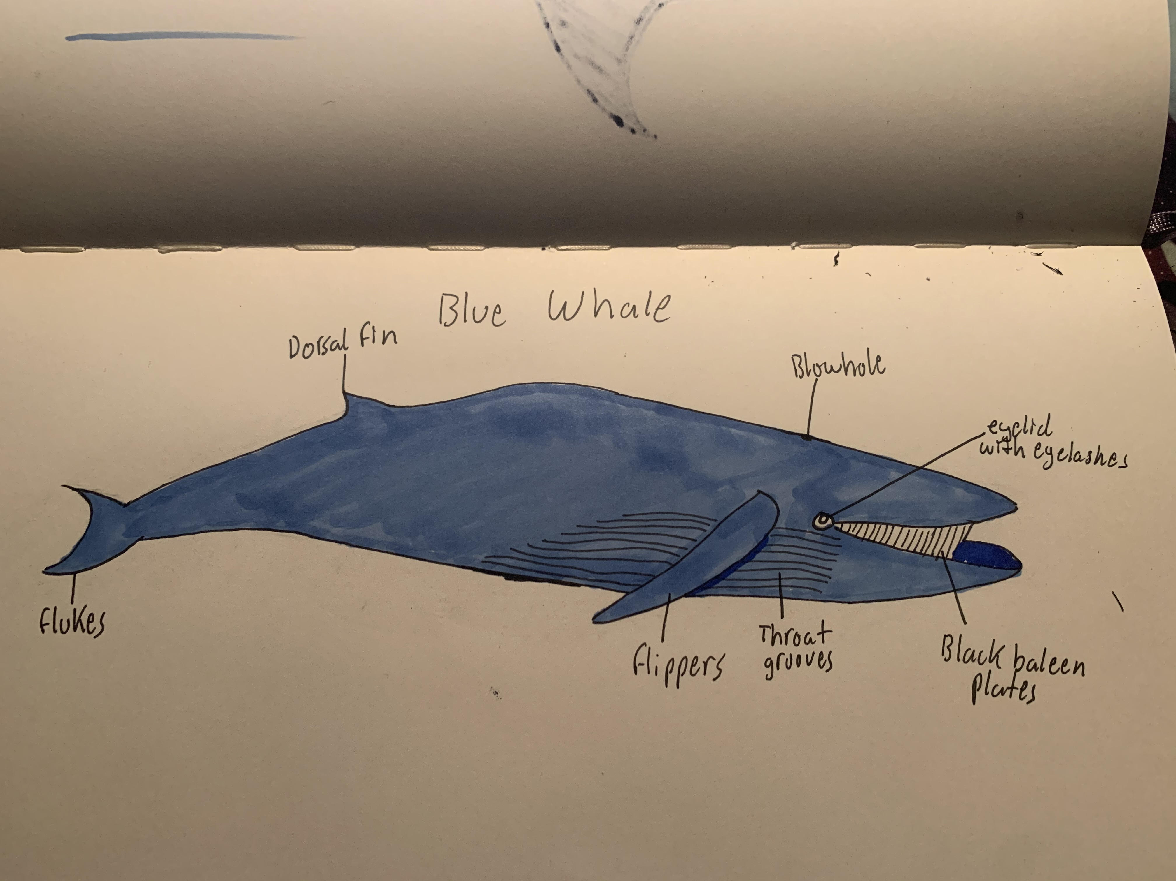
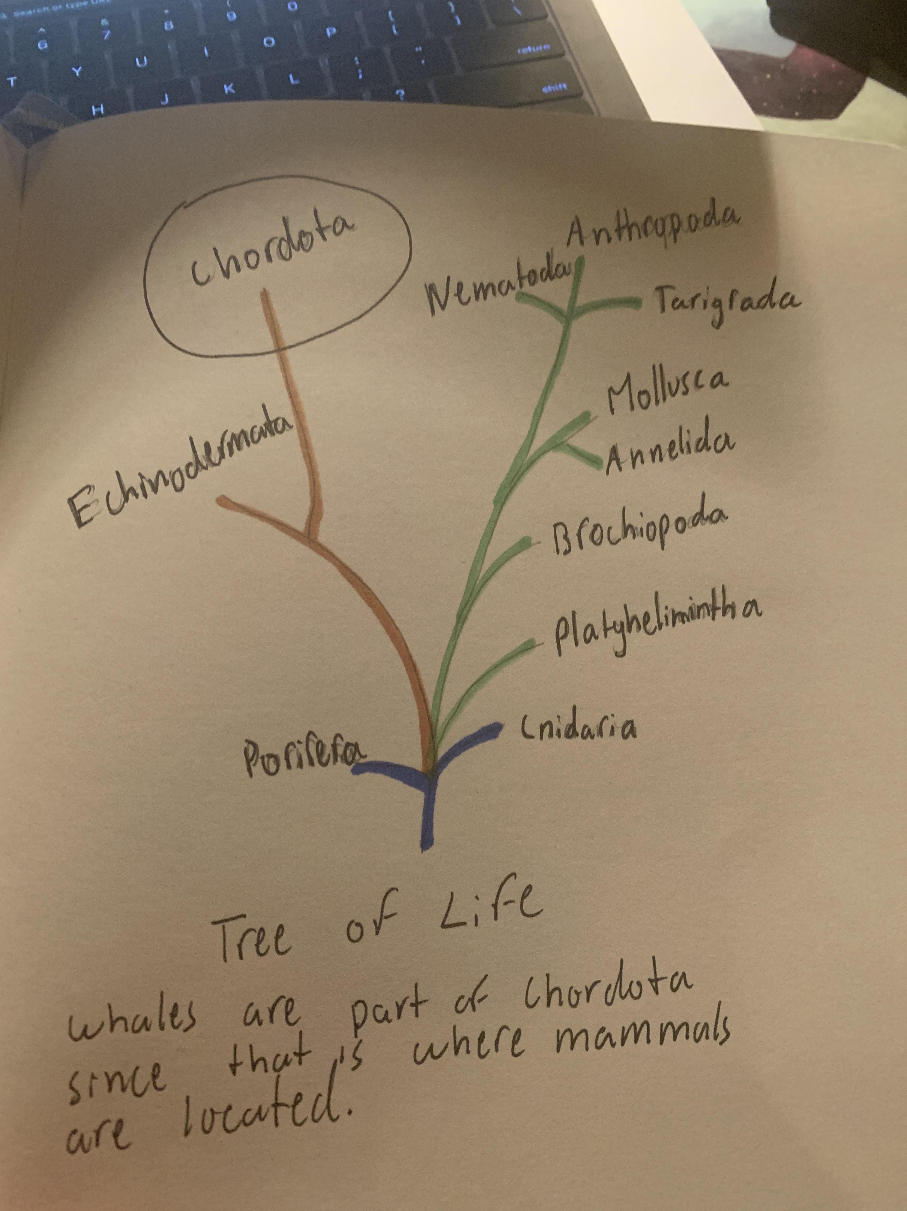
Whales: Max Renwick
Common Characteristics: Whales breathe air and are warm blooded, and produce milk to feed their young. They have nearly hairless skin and an insulating layer of blubber.
Whales roam throughout the world's oceans, they communicate with complex and mysterious sounds. Although whales live in the ocean, they breathe air, and are warm blooded animals that nurse their young like humans. Whales have thick layers of fat called blubber that insulates them from cold oceans water.
There are 90 species of whales, dolphins and porpoises, known collectively as "cetaceans"

Slide 17
Narwhal Blue Whale
Classification: Eukaryote, Animalia, Chordata, Mammalia , Artiodactyla, Monodontidae, Monodon monoceros
Habitat: Narwhals live in icy waters in the Arctic seas. During the winter they live in deep water beneath the ice in packs of 5-10. They migrate to more shallow ice free waters where they gather in larger groups, they rarely leave the ice.
Predators: The main predator is the killer whale, but can also be hunted by polar bears and walrus.
Diet: Narwhals diet includes fish, squid, and shrimp.
Reproduction: They reproduce by sexual meiosis.
Interesting Facts:
The tusk that a Narwhal has can grow 10 feet long, a regulation basketball hoop is 10 feet tall.
During the winters, Narwhal have made some of the deepest dives by a mammal, from 2,600 feet to 4,000 feet over 15 times a day.
Classification: Eukaryote, Chordata, Mammalia, Artiodactyla, Balaenopteridae, Balaenoptera musculus
Habitat: The blue whale lives in every ocean in the world. They have been found in the Arctic, Tropical, Subtropical, and Temperate seas.
Known Predators: Killer whales are the only recorded animal to attack a Blue Whale, they are also near extinction because of Humans that hunt them.
Diet: Blue Whales filter their food through their baleen plates, they eat krill and copepods.
Reproduction: They reproduce by sexual meiosis.
Interesting facts:
A blue whale can eat up to 8,000 lbs of krill during its peak consumption period.
The blue whale is the largest animal to ever live on earth.

Slide 18
Frogs: Bella Quintero
A frog is described as any different tailless amphibians that are categorized into the order Anura. When used strictly, the term frog is limited to any member of the family Ranidae. More broadly, the term frog is used to distinguish smoothed-skinned anurans from rough-skinned anurans, which are referred to as toads. On the evolutionary tree, Frogs are located in the eukarya section of the tree, on the animals branch, under the class amphibia.
Some common characteristics of animals in the amphibian group is moist, scale-less skin, which can absorb water and oxygen, cold-bloodedness, and are found in habitats near marshes, ponds, or anywhere that has freshwater accessible. As of now, there are 4,810 species of frog in the world. An estimated 200 frog species have gone extinct as of 1970.

Slide 19
American Bullfrog American Green Tree Frog
Classification: Eukaryote, Animalia, Chordata, Amphibia, Anura, Ranidae, L. catesbeianu
This species of frog is native to eastern north America. The american bullfrog’s habitat is usually near large, permanent bodies of water, but they can also reside in smaller creeks and streams. Occasionally, bullfrogs are found in urban areas near ditches or culverts. There is a wide variety of predators for bullfrogs and their eggs, depending on the area the bullfrog is inhabiting. This includes herons, such as great blue herons and great egrets, turtles, water snakes, raccoons, and belted kingfishers. American bullfrogs are also predators themselves, and often eat insects, smaller frogs, worms, tadpoles, aquatic eggs, and they will also not hesitate to eat their own kind. During their breeding season, which typically lasts two to three months, males occupy a three to six feet territory and produce mating calls in order to attract females.
Interesting facts:
The american bullfrog is the largest species of frog native to the United states. It can reach 3.5 to 6 inches and can weigh up to 1.1 lbs.
This species was named bullfrog because the males mating call sounds similar to cows mooing.
This mooing sound is very loud and can be heard over half a mile away.
Bullfrogs are most active during night, meaning they are nocturnal.
An american bullfrog can live for up to 10 years in the wild, and up to 16 years in captivity.
Classification: Eukaryote, Animalia, Chordata, Amphibia, Anura, Hylidae, D. cinereus
This species is native to central and southeastern United states, and, like the american bullfrog, the american green tree frog’s habitat is always near a body of freshwater. The american green tree frog prefers habitats with grasses, cattails, and aquatic plants, but can often be found in backyard swimming pools. Also similar to the american bullfrog, there is a wide variety of predators for american green tree frogs. This includes snakes, birds, large fish, and certain species of toads. American green tree frogs are insectivores, and their diet mostly consists of flies, mosquitoes, and crickets. This species breeds once per year during the summer. Just like the american bullfrog, males will produce a mating call to attract females attention, and males will mate with as many females as possible. However, unlike the american bullfrog, american green tree frogs do not occupy any sort of territory. Breeding is heavily influenced by day length, temperature, and precipitation. The frogs generally breed following rainfall, and males call more frequently as temperature and day length increase.
Interesting Facts
The american green tree frog is the state amphibian of both Louisiana and Georgia.
The american green tree frog is listed in the IUCN data as a species of least concern, but this particular species of frog is what's known as an “indicator species”, meaning that any changes in the abundance of frogs could suggest habitat degradation.
Studies show that frogs do not choose their prey by size, but by how active the insect is, meaning the most active insects will be eaten.
This species of frog is medium-sized and can grow up to six centimeters long.

Slide 20
Sharks: Caleb Moon
Common Characteristics:
Fins - generate a lift to keep the shark buoyant and keeps the shark stable as it swims
Gills - as sharks swim, water is driven through their mouth and out their gills and the oxygen in the water is absorbed by tiny blood vessels. This process is called “ram-ventilation”. Other sharks can oxygenate without swimming through a process called “buccal pumping”. Fish have bony plates covering their gills called the operculum and it is used to breathe without swimming forward. The fish open their mouths and close the operculum, sucking water in, and then close their mouths and open the operculum, running water through their gills. Since sharks do not have bone and are cartilaginous, their gills are exposed but some shark species can still use modified buccal pumping to breathe without swimming.
Spiracle - some species of sharks use spiracles, valves behind their eye, to draw water into their bodies and through their gills to breathe while stationary
Teeth - teeth made of enamel that vary greatly depending on the species and the feeding habits of the species.
Skin - shark skin is made of millions of tiny teeth called dermal denticles. These teeth point backwards and reduce drag of the shark, making them very hydrodynamically efficient.
Liver - a shark's liver is about 25% of its body weight (compared to mammals’ 5% of body weight) and is quite large and stores low density oils to keep the shark light
Skeleton - the shark's skeleton is made of cartilage and not bone to keep the shark light and buoyant
Muscles- sharks have 2 types of muscle: red and white. Red works by breaking down fats and helps the shark swim for long periods of time. White works by breaking down sugars (glycogen) and enabling sharks to make short and fast sprints to chase prey or flee from danger. Sharks have long bundles of muscle fiber that run from the tops of their heads to their tails. Sharks swim by slowly gaining speed through a series of small muscle contractions and the stiffen their entire body to glide through the water once they gain enough momentum

Slide 21
440 different shark species

Slide 22
Common Thresher Greenland Shark
Eukarya Animalia Chordata Chondrichthyes Lamniformes Alopiidae Alopias vulpinus
Migratory, lives in tropical and cold-temperate waters worldwide. Usually stays within 30 km of the coast and about 40 m below the waters surface. Prefer temperatures of about 16-21 degrees C
No known natural predators. Juvenile sharks can fall prey to larger sharks.
Feed mostly on bony fish. Small schooling forage fish (Mackerel, Bluefish, Herring, Needlefish, Lanternfish)
The common thresher has an aplacental viviparous mode of reproduction, with oophagous embryos that feed on undeveloped eggs ovulated by their mother. Females typically give birth to four pups at a time, following a gestation period of nine months.
The thresher shark uses its long upper lobe of their caudal fin to stun and incapacitate their prey
Eukarya Animalia Chordata Chondrichthyes Squaliformes Somniosidae Somniosus microcephalus
As an ectotherm living in a just-above-freezing environment (-2 to 7 degrees celsius), the Greenland shark has the lowest swim speed and tail-beat frequency for its size across all fish species, which most likely correlates with its very slow metabolism and extreme longevity. The Greenland shark is an ectotherm that lives in just above freezing environment. They migrate annually depending on depth and temperature and have been observed at depths of 2200 meters in the arctic and northern atlantic waters.
No known natural predators
Greenland sharks feed on fish, skates, eels, seals, small crustaceans, jellyfish, sea urchins, crabs, squids and other sharks. They also eat carrion, the flesh of dead whales and have been known to feed on reindeer and caribou that stand close to open holes in the ice
Greenland sharks reproduce through internal fertilization and give live birth. Though they give live birth, Greenland sharks do not connect to their young through a placenta. Instead, the embryos survive off of yolk sacs attached to each individual.
The Greenland shark can grow up to 24 feet (7.3 m) and 2200 pounds (1000 kg), and is one of the largest sharks in the ocean. Due to their slow metabolism and growth rate, Greenland Sharks have estimated lifespans of about 500 years.

Slide 23
Octopus: Amanda Taylor
Common characteristics of animal group
The octopus is a bilaterally symmetric creature with two eyes at the sides of its bulbous head (called the mantle) and eight arms with suction cups. Because the suction cups are on the whole length of each appendage, they are called arms rather than tentacles. Each suction cup has chemoreceptors that allow the octopus to taste everything it touches with its arms. These arms also have two thirds of an octopus’s neurons, allowing each to perform a variety of complex reflex actions independently from the brain (found in the mantle). The brain-to-body mass ratio itself is the highest among all invertebrates, and is even higher than that of many vertebrates. As a result, the octopus is incredibly intelligent.
While it varies from species to species, octopuses also have a great perception of color. A group of proteins called opsins in the skin can sense various wavelengths of light so that the octopus knows what to camouflage into given their surroundings. However, not all octopuses change color to blend in with their environment. The chromatophores - organs under the skin containing pigment sacs that change in visibility as small muscles pull on them - can also change an octopus’s color to scare away threats.
The two siphons below the eyes are for respiration and locomotion. Each siphon can expel a jet of water that pushes the octopus’s body through the water. They can also expel ink from their ink sac as a way of distracting predators as they escape. Because the octopus is an invertebrate, its soft body can squeeze through incredibly small spaces. The only hard part of its body is a sharp beak at the center of its eight arms used for the first steps of digestion. As carnivores, their meal generally consists of small fish and other molluscs, and they eat by enveloping their prey with their arms and pulling them into their beak. The octopus comes with three hearts: one that pumps blood through the body, and two that pump blood through the gills.

Slide 24
Number of species: There are roughly three hundred recognized species of octopus.

Slide 25
Greater Blue-Ringed Octopus Giant Pacific Octopus
Classification: Eukarya, Animala, Mollusca, Cephalopoda, Octopoda, Octopodidae, Hapalochlaena, lunulata
Habitat:
Tropical and subtropical areas in the Indian and Pacific Ocean
At the bottom of sandy/silty areas of coral reefs, tidepools, and algae clumps
Shallow water (0-20 m)
They can hide in rock crevices, empty seashells, and in trash like empty bottles
Known predators: Whales, Moray eels, Sea birds
Diet: Small crabs, Hermit crabs, Shrimp, Small fish (only sometimes)
Reproduction:
They begin reproducing at less than a year old
Male pounces on the female, occasionally pouncing on males accidentally
The male insert his hectocotylus (a specialized arm on males) into the female’s mantle cavity and releases spermatophores
Female lays 50-100 eggs shortly after mating
For roughly 30 days, the female broods her eggs in a cluster on her arms under her mantle
She typically does not eat during this period and often dies shortly after the eggs hatch
The eggs hatch into a small larva called paralarva averaging 4 mm long
These larvae swim freely in the ocean for about a month to gain weight before settling onto the ocean floor
Interesting facts:
Their saliva contains tetrodotoxin, a venom stronger than that of any land mammal
It is typically used to immobilize its prey before eating it
It is incredibly fatal to humans, causing muscle and respiratory paralysis, but not affecting the person's consciousness
This venom can also be found in their eggs
They have bright blue rings that change in iridescence depending on their stress as a way to ward off predators
Classification: Eukarya, Animala, Mollusca, Cephalopoda, Octopoda, Enteroctopodidae, Enteroctopus, dofleini
Habitat:
The coastal North Pacific
Temperate, oxygen-rich water
They typically live on the ocean floor (~91m) in dens made from rock crevices
Known predators: Scavengers like crab or lobster often try to eat their eggs, Harbor seals, Sea otters\, Sperm whales, Pacific sleeper sharks, Humans
Diet: Shrimp, Crabs, Scallop, Abalone, Cockles, Snails, Clams, Lobsters, Fish, Other octopuses
Reproduction:
Male pounces on the female and inserts his hectocotylus into her mantle cavity, releasing spermatophores
The females stores the spermatophores in her mantle until she is ready to fertilize them
Female lays 120,000 to 400,000 eggs shortly after mating
Very few live to adulthood
The female attaches her eggs to the roof of her den, continuously blowing water at them and grooming them to prevent algae and other growths
She does this for sixth months, all the while not eating. She dies shortly after the eggs have hatched
The eggs hatch into a small larva called paralarva averaging 4 mm long, but they have a growth rate of 0.9% per day
These larvae swim freely in the ocean for about a month to gain weight before settling onto the ocean floor
Interesting facts:
Adult giant pacific octopuses typically weigh 33 lbs and have an arm span of 4.3 m, but they can get to be 110 lbs with an arm span of 6 m
Because of their size, giant pacific octopuses are commonly displayed at aquariums. They have been found to recognize people they frequently come in contact with by performing specific actions for specific people
The actions can include changing color or jetting water
They’ve been shown to open childproof jars, mimic other octopuses, and solve maze puzzles
Giant pacific octopuses in captivity have been known to try and escape. One from the National Aquarium of New Zealand named Inky successfully squeezed through his tank, crawled on the floor, and slipped through a 15 centimeter wide drainpipe that led to the ocean

Slide 26
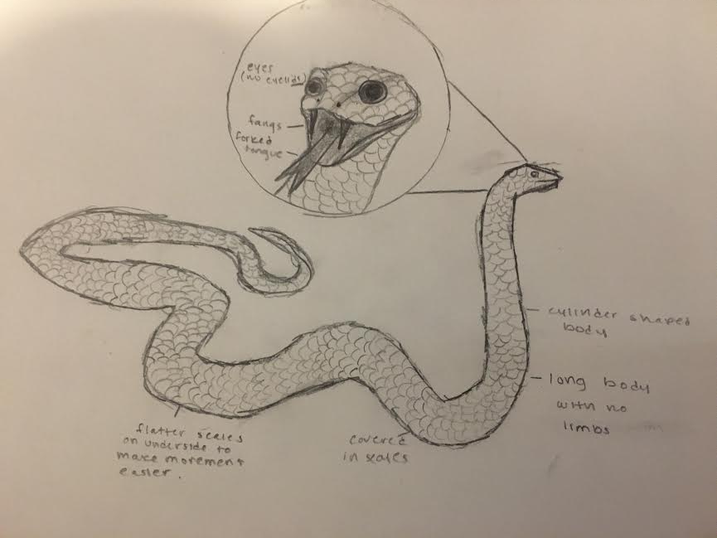
Snakes: Katya Gilmore
Place in Evolutionary Tree: Snakes are part of the class of reptiles, which are in the phylum of chordata, or animals with a backbone. This section is in some of the highest branches of the kingdom of animalia, near the top of the tree, as these animals, including snakes, are some of the most complex organisms. It is in the domain of eukarya, which encapsulates much of the top of the tree.
Common Features: Snakes have elongated, cylindrical bodies without any limbs of any kind. They are covered in scales, with flatter scales on their undersides in order to make it easier for them to move. Snakes do not have eyelids or ear flaps. Snakes, like other reptiles, are “cold blooded” so their body temperature is determined by the outside temperature. Snakes have large, backwards facing fangs and forked tongues. Snakes do not use these fangs to chew their food, just to catch prey, as they swallow their food whole. Some snakes have fangs that contain venom in order to kill prey, and many snakes use their tongues to navigate the world around them. Snakes also have a strong sense of smell, another way that they can find prey and find their way in the world, as most snakes do not have very good eyesight. Most snakes lay eggs, a feature common to reptiles, however, there are some species of sea snakes that give birth to live young.
Species: It was difficult to find a consistent number for the amount of snake species, but most hover around the 3400-3800 mark. A statistic from 2019 has the number at 3789.

Slide 27
Western Diamondback Rattlesnake Yellow Bellied Sea Snake
Eukaryota, Animalia, Chordata, Reptilia, Squamata, Viperidae, Crotalus, atrox → C. atrox
Western Diamondback Rattlesnakes live mostly throughout the southwestern United States. It can live in many different habitats, such as deserts, grasslands and forests. These snakes have many predators, some of which include birds of prey, coyotes, foxes and bobcats. They have a diet mostly consisting of small animals, like small rodents, rabbits, lizards and birds. They mate once a year, and young are born in late summer. Unlike many species of snakes, Western Diamondback Rattlesnakes give birth to live young, and they give birth to about 25 at a time. The most notable feature of the Western Diamondback is its distinctive rattle on the end of its tail. These snakes can shake their rattles 60 times per second. The rattle is also made out of keratin, the same material that makes up human hair and fingernails, as well as other animal features, like rhino horns. They are pit vipers, which means that they find their prey using pits behind their nostrils that sense heat.
Eukaryota, Animalia, Chordata, Reptilia, Squamata, Elapidae, Hydrophis (some consider it to be in the Pelamus genus), platurus → H. platurus
Yellow Bellied Sea Snakes are found throughout the Indian and Pacific Oceans. They are one of the most widespread species of snake, and can live anywhere from the east coast of Africa to the west coast of Central America. It lives in the open ocean. These snakes have very few predators, due to their yellow and black coloration that acts as a warning for their extremely dangerous venom. They eat mostly small fish, like anchovies, damselfish and mullet. Yellow Bellied Sea Snakes do not reproduce in a seasonal pattern, so they mate and have young at all times of the year. They are also part of a minority of snakes that bear live young, instead of laying eggs. The baby snakes are pretty much miniature adult snakes, and can feed and function right as soon as they are born. An interesting fact about this species of snake is that it has extremely dangerous venom. The venom is a neurotoxin that blocks nerve transmissions to muscles, and can cause organ failure and damage, as well as muscle tissue breakdown.

Slide 28
Penguins: Hannah Lasky
Evolutionary Trees: The penguin falls close to the top of the evolutionary tree. Being close to the top, they are an evolved species that have adapted to their environment over several years. They are in the classification of animalia, so they will be on the left side of the evolutionary tree. Penguins have been evolving on this planet for 50 million years, so it makes sense that they are so high on the evolutionary tree.
There are 18 different species of penguins
Common Characteristics:
All species of penguins live in the southern hemisphere
All species are incapable of flight
Penguins have blubber and thick oily feathers that are ideal for cold weather

Slide 29
Emperor Penguin Gentoo Penguin
Classification: eukaryota, Animalia, Chordata, Aves, Sphenisciformes, Spheniscidae, Aptenodytes forster
Habitat: These penguins live in colonies in Antarctica over much of the continent, they live in colonies of a few hundred penguins to over 20,000 penguins
Known Predators: Emperor penguins are close to the top of the food change in the antarctic, but they will sometimes be eaten by leopard seals and orcas, while chicks will sometimes be eaten by other birds such as petrels
Diet: They dive deep into the ocean for different types of food. One of the most important sources of food are silverfish. They also eat krill and some different species of squid.
Reproduction: They are the only animal that breeds during winter in Antarctica. Only the male penguins incubate the eggs, but both parents are very involved in the care of the child.
They will huddle in large groups in order to keep eggs and chicks warm.
Classification: eukaryota, Animalia, Chordata, Aves, Sphenisciformes, Spheniscidae, Pygoscelis papua
Habitat: Antarctic peninsula and the islands surrounding Antarctica
Known Predators: Orcas, Leopard seals, sea lions, sharks, all aquatic, as they have no known land predators
Diet: eat fish, squid and krill. They are known to dive up to 650 feet in order to catch their prey.
Reproduction: Gentoo parents work together to create nests to raise their young in. Both parents will typically take turns sitting on the egg for more than a month. Once hatched, chicks stay in the nest for up to a month, where the parents will share childcare responsibilities.

