Slide 1
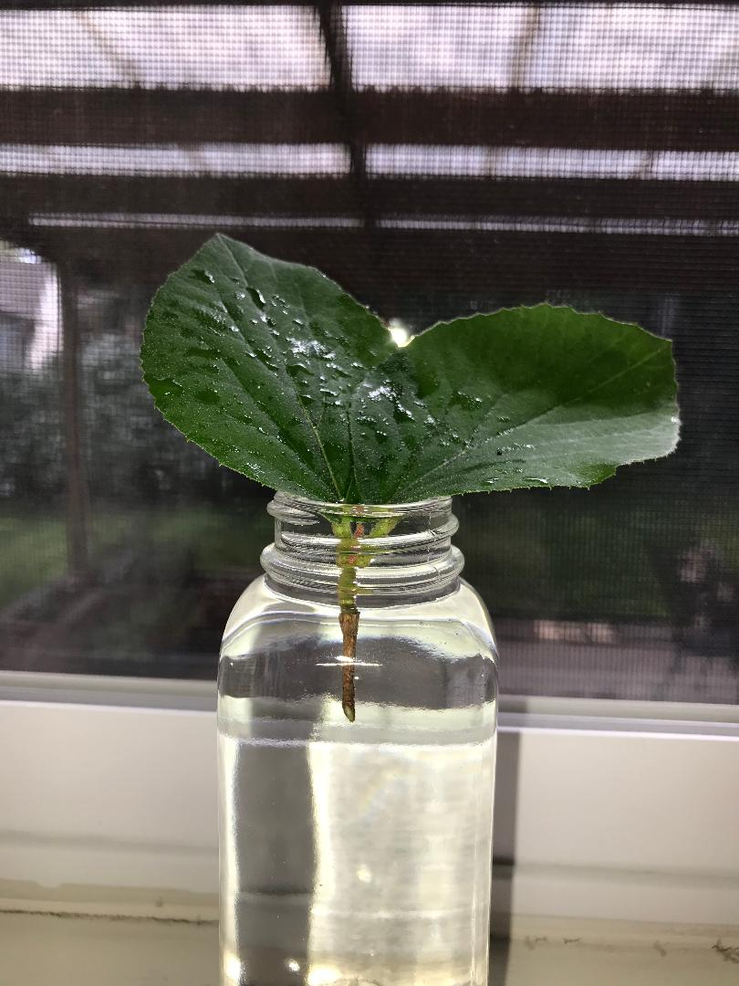
Transpiration Lab
Open up a document. Make your way through this slide show and answer each question. You will also make a data table and a graph. Submit your completed lab to Turnitin.com.

Slide 2
Background: 1. What is transpiration? 2. Of what use is transpiration to plants?(Hint: We talked about this when we covered the properties of water in the Biochemistry Unit. Also useful… The Google.)

Slide 3
I set this up using test tubes that I brought home from school. If you want to try it yourself (optional), choose containers that are narrow with a small opening at the top. You will need 3 identical containers.

Slide 4
Setting up the experiment… Cut leaves of different sizes from the same plant and quickly submerge them in water to avoid air bubbles in the vascular tissues that transport water (xylem).

Slide 5
Place the leaves in test tubes filled with water. Make sure the petioles are fully submerged. Place them together in a place where they will be subjected to the same environment for the next 48 hours.

Slide 6
3. Measure the initial height of the water in each test tube at the beginning of the experiment. Record in a data table of your own design. (Remember to include units and uncertainty.)
Small Leaf

Slide 7
Medium Leaf
Large Leaf

Slide 8
4. Measure the length of each leaf blade and record. (Remember to include units and uncertainty.)
Small Leaf
*I actually did this step at the end of the experiment so the leaves were never outside water, but we need the information now to make a prediction!

Slide 9
Medium Leaf
Large Leaf

Slide 10
5. What is the manipulated variable in this experiment? 6. Predict the trend in change in water height after 48 hours.

Slide 11
7. Measure the final height of the water in each test tube at the end of the experiment. Record.
Small Leaf

Slide 12
Medium Leaf
Large Leaf

Slide 13
8. Find the change in height of water for each leaf.
9. Graph the results. You may use Logger Pro or any other graphing program.
Be sure your graph has:
- a descriptive title
- labels, units, and error bars
- an annotation where you describe the trend shown by the graph
(Ex. As the ________ increases, the _________ increases/decreases.)
10. Further analysis:
a. List 3 controlled variables in this experiment. Be specific.
b. I forgot to include a control test tube! What would this test tube
contain? Why would it be useful?
c. Other than including a control test tube, identify one weakness or
error in this procedure, its impact on the results, and a suggestion
for improvement.

