Slide 1
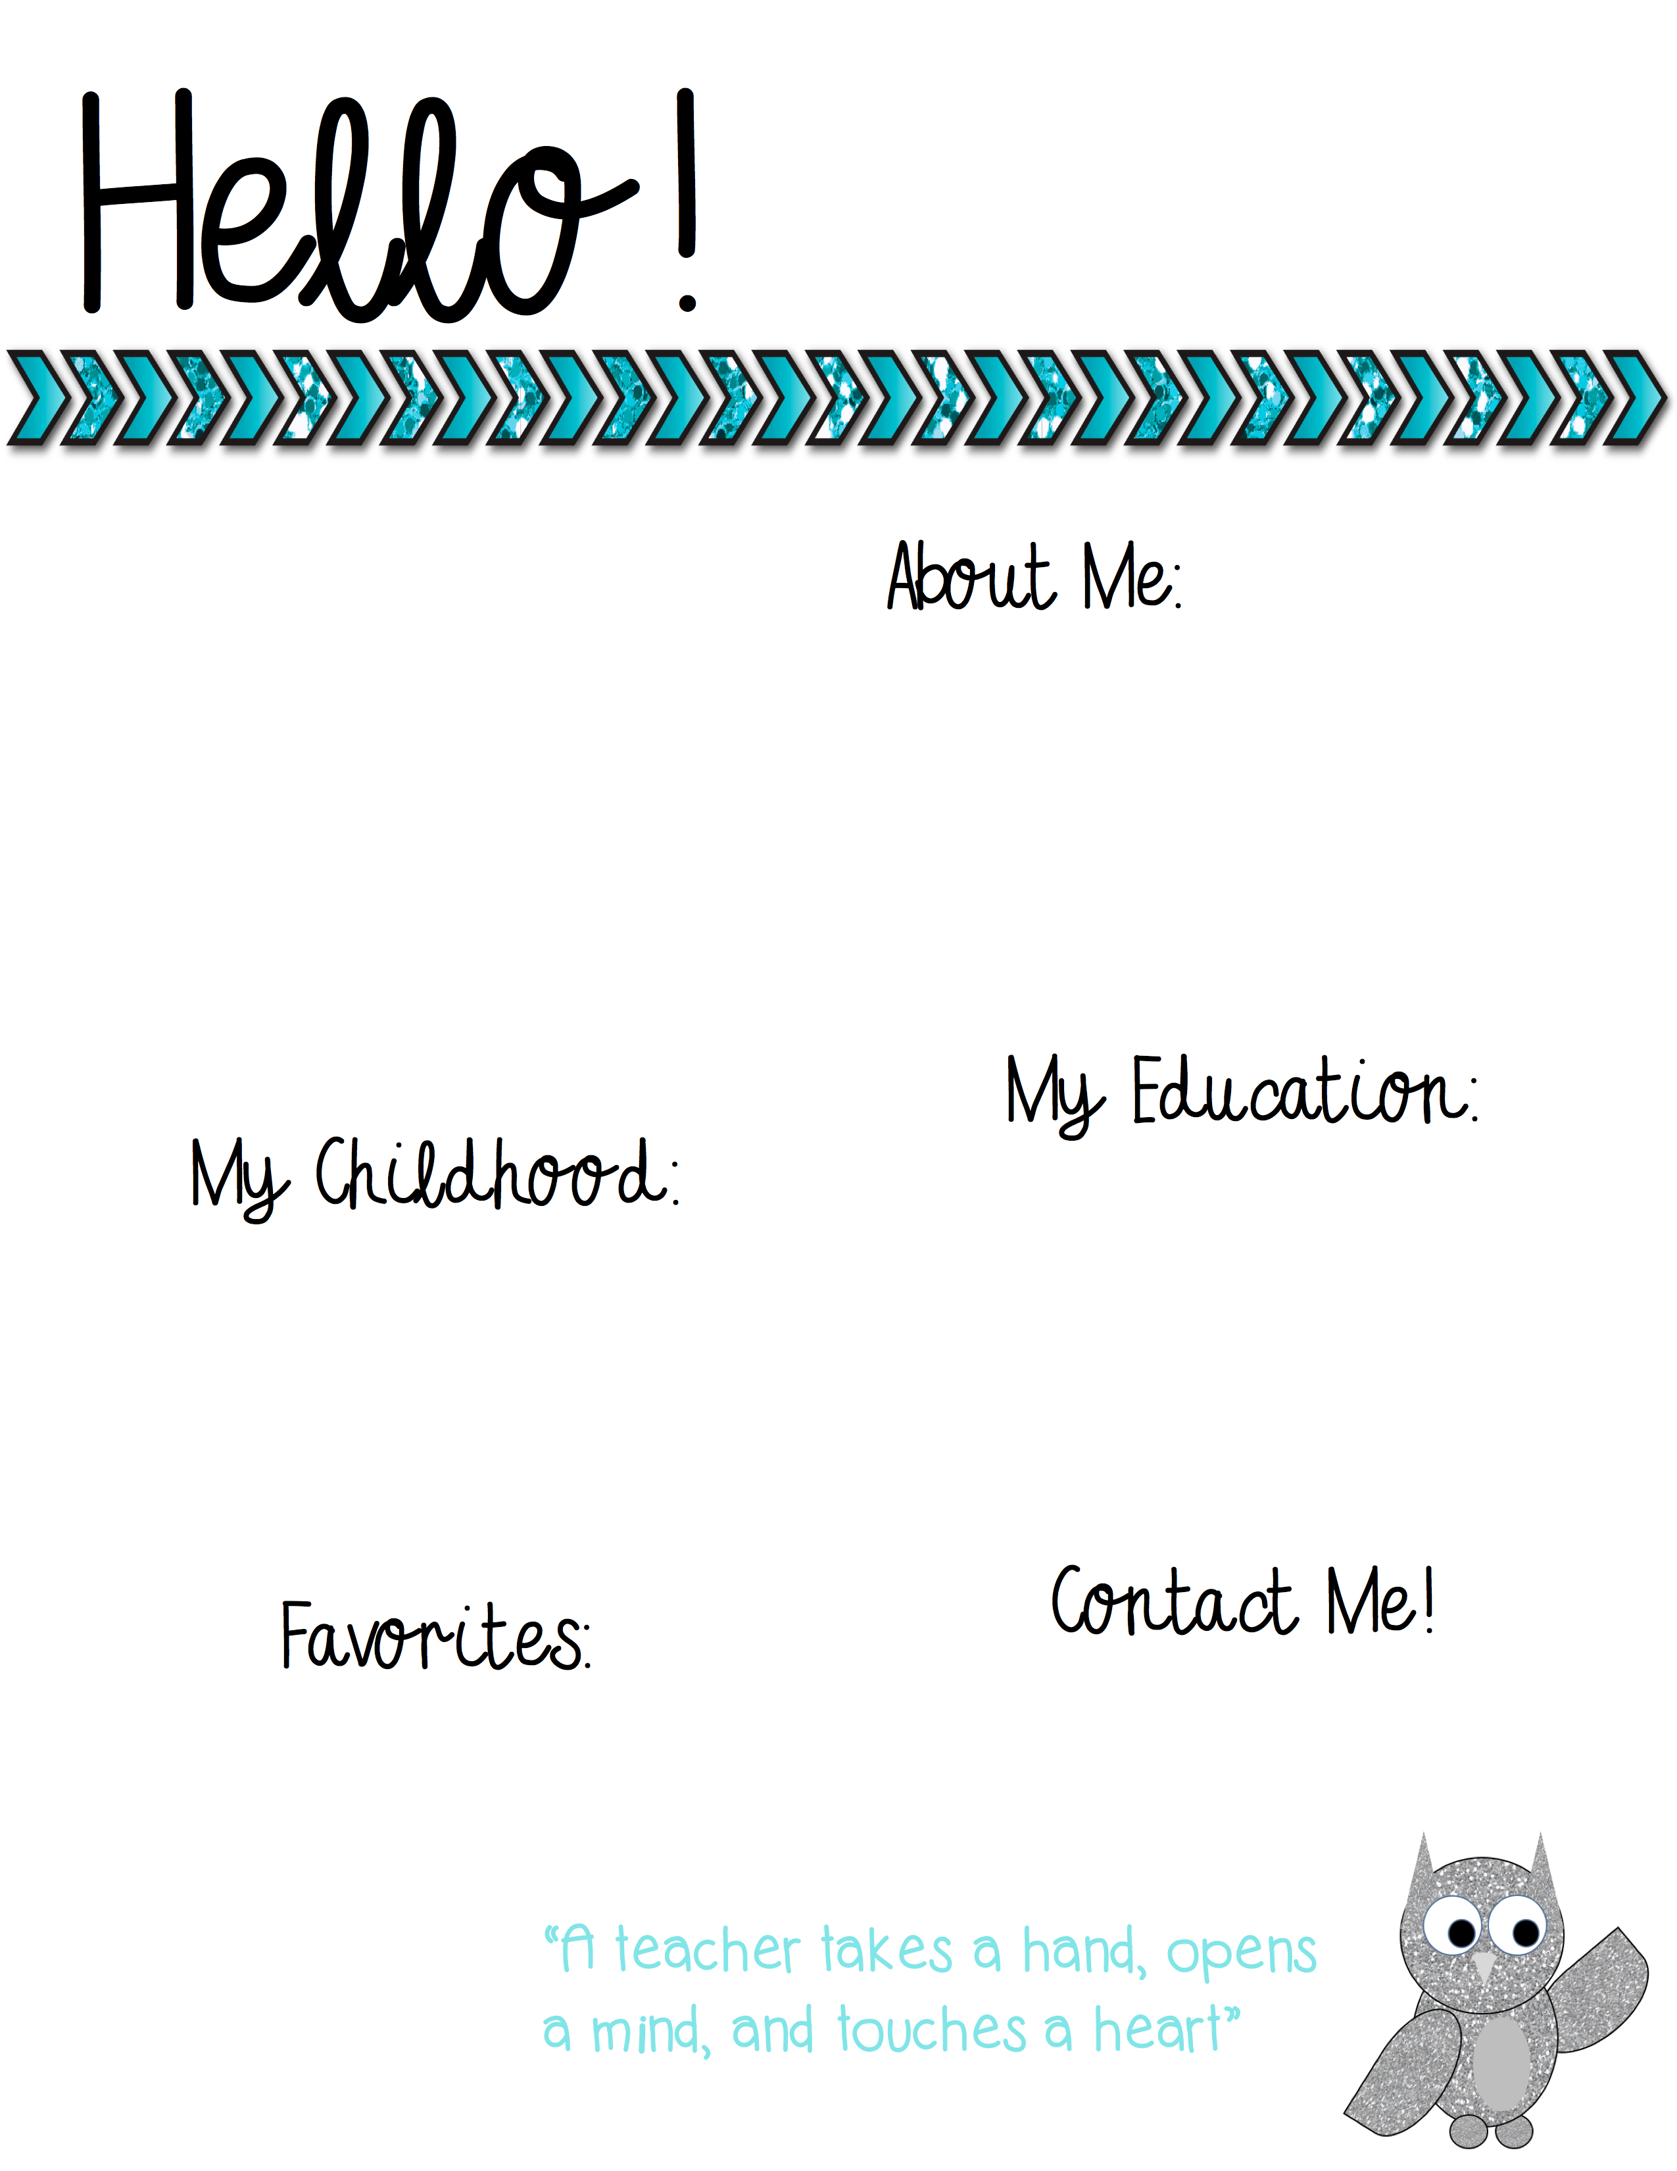
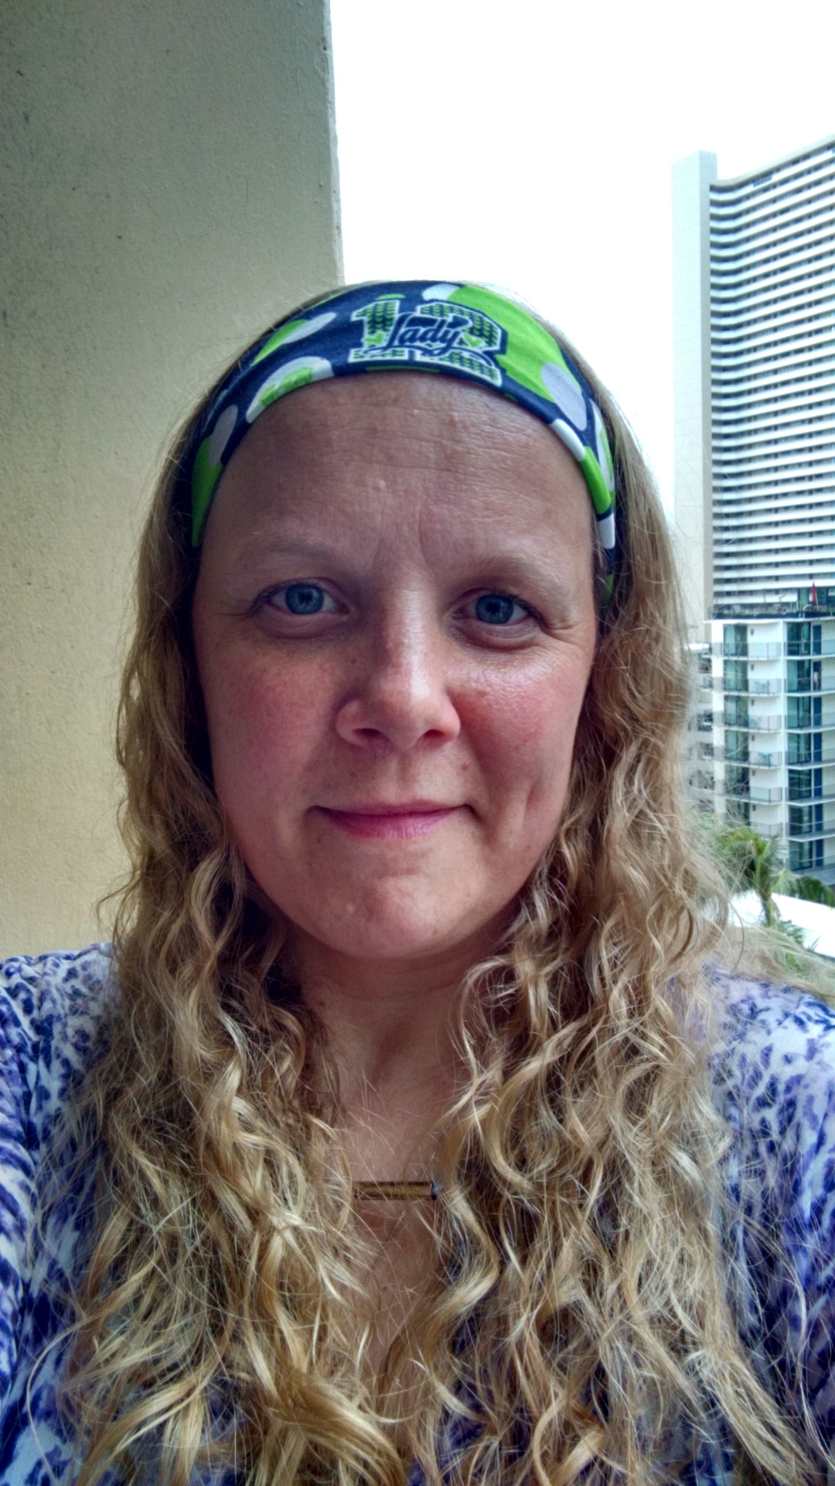
Welcome back, I’m Mrs. McNulty and I am so excited to be your teacher this year!
My name is Teri McNulty (was Cahill, I got married this summer) and I am so honored to be your 3rd grade teacher for the 2016-2017 school year! I am 39 years young! This will be my third full year teaching at Faubion School and there’s no place I’d rather be!
Insert picture here!
I graduated with a Bachelors in Elementary Education from Concordia University. I’ve always had a love for helping children learn and knew I wanted to pursue my dream of teaching when my son began school.
I spent most of my childhood in Walla Walla, Washington. I attended school there from 5th grade through High School. I graduated from Walla Walla High School. A few years after high school, I became a mom and moved back to Vancouver, Washington where I found I wanted to become an educator.
Coffee: Starbucks
Book: The Poky Little Puppy
Movie: Cinderella
Subject: Math
Store: Disney Store
Candy: M & M’s
Dessert: Lays potato chips
and Dr. Pepper
Email: tcahill@pps.net
School Phone Number: 503-916-2625

