Slide 1
Sustaining a Thriving Workforce in Fiscal Uncertainty
Article 12 - Compensation
March 7, 2023
Notes:
GR notes - In advance of sharing our compensation proposal, we wanted to share with you the why behind our proposal and the fiscal reality that PPS is facing.

Slide 2
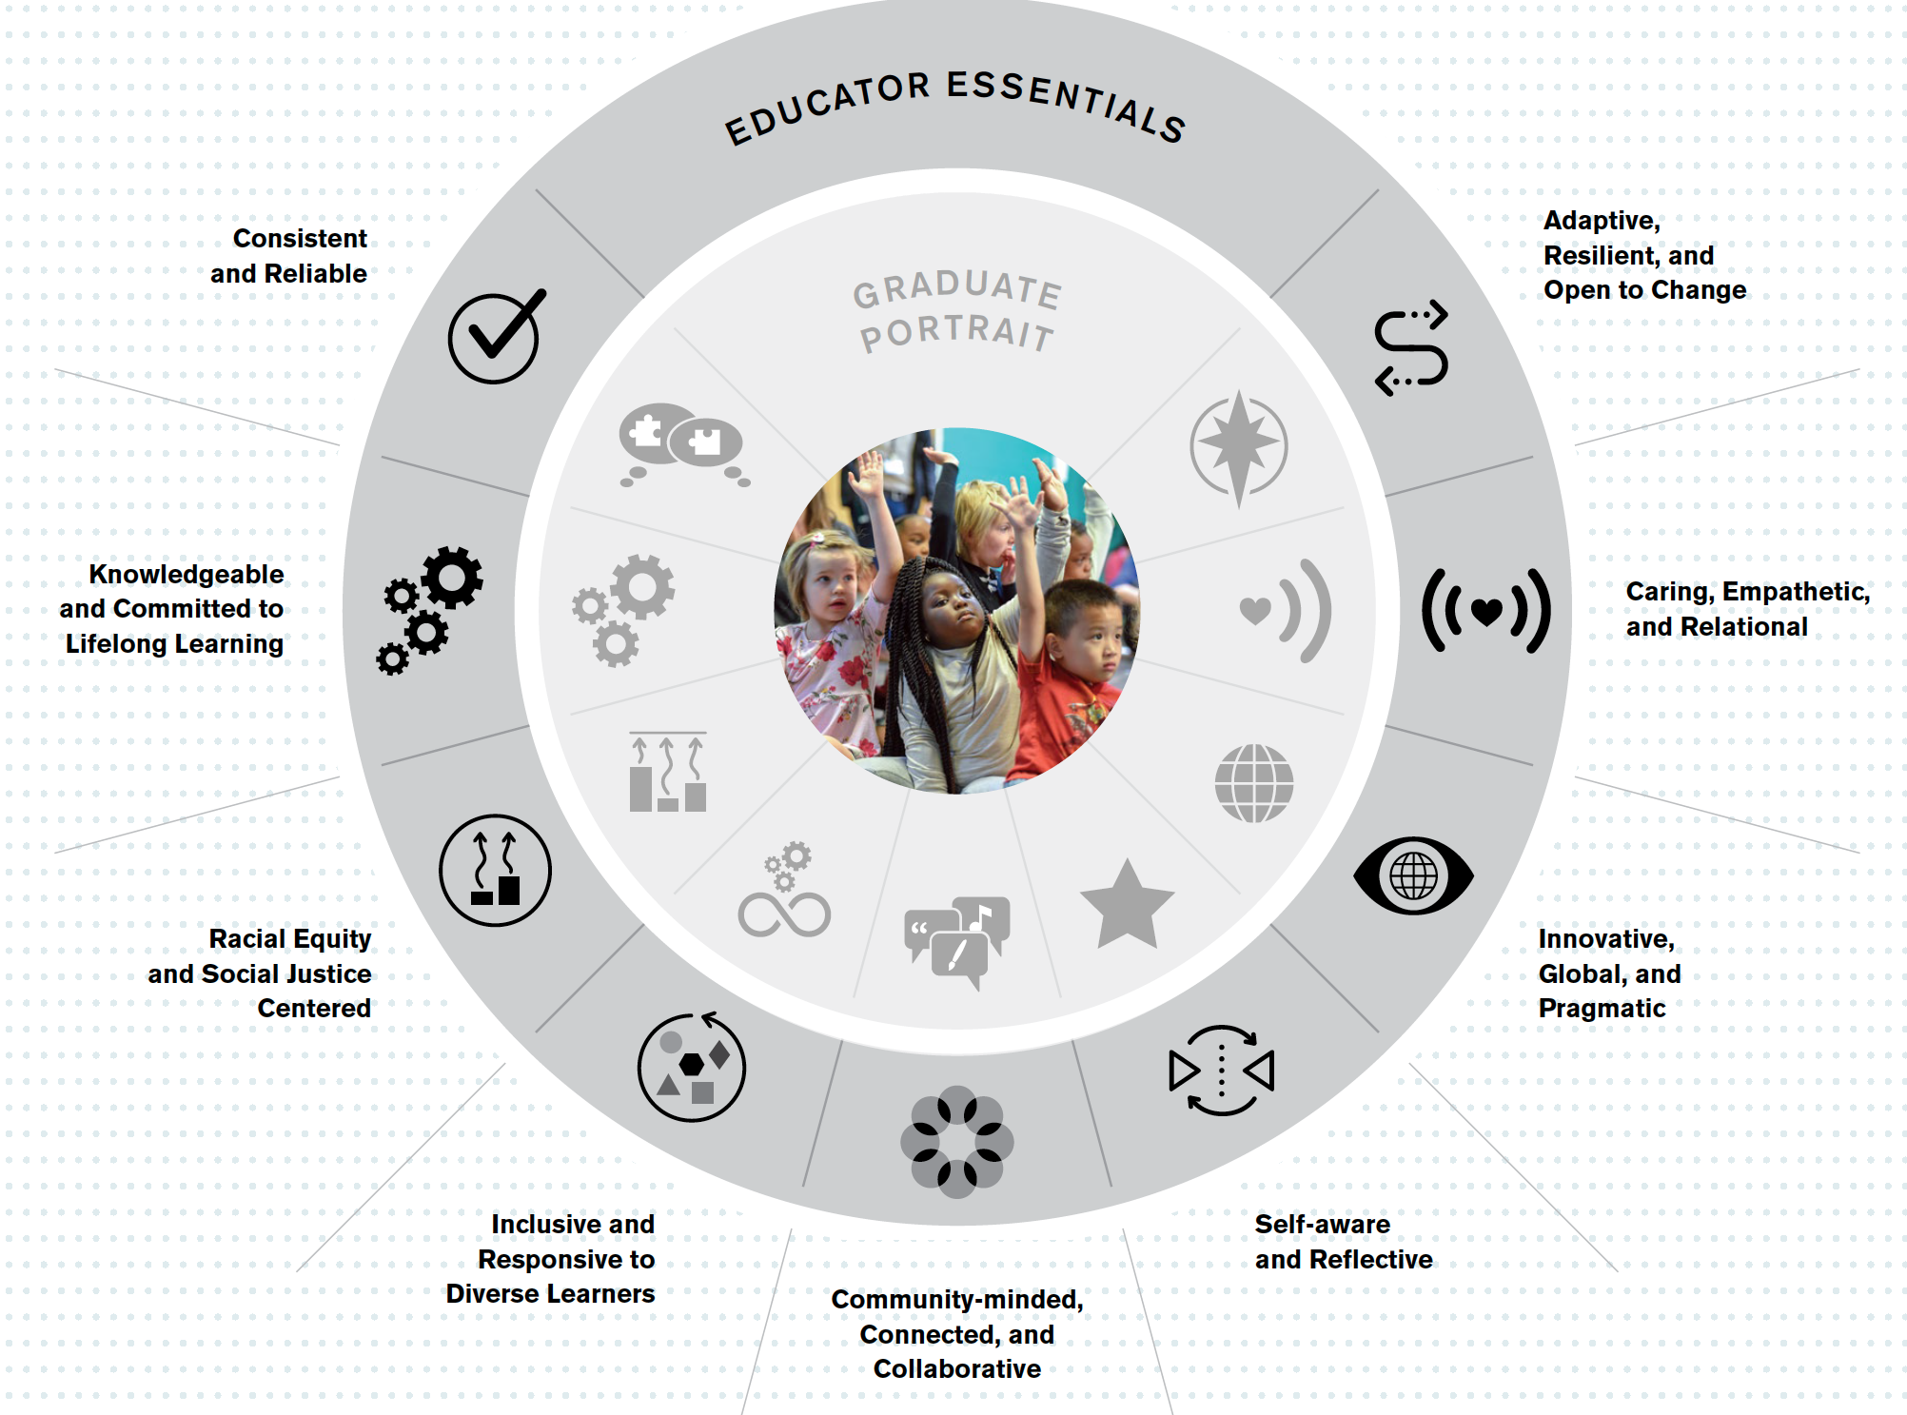
Forward Together
Our community’s vision for PPS cannot be achieved without a supportive community of adults who intentionally model, teach, and create the conditions students need to succeed.
Develop a Diverse, High-Quality, Thriving Workforce PPS strives to have a diverse, high-quality, thriving workforce that is supported in personal and professional well-being and success.
Build a Collective Sense of Trust and Belonging
Our PPS educators and community collectively foster an environment of belonging, trust, and shared ownership for the success of our students, educators, and school district.
Notes:
GR notes - we have grounded our proposal in two of our strategic outcomes that are focused on the adults that serve our students.

Slide 3
Our Balancing Act
Sustaining A Thriving Workforce
To realize on our vision for our students, we must have a thriving workforce.
This means remaining competitive in the job market to attract and retain talented staff.
It also means creating the best working conditions.
Fiscal Uncertainty
Current revenue is not keeping pace with the cost of operating our school district.
We’ve lost over 3,000 students since onset of the pandemic, and expect to lose approximately 500 more next year. One-Time Federal Covid Relief dollars are phasing out. We are planning for leaner budgets.
Notes:
Our obligation to balance a budget is both short and long term. When we forecast, we have to consider variables such as the state school fund and student enrollment. These unknowns substantially impact our ability to responsibly make financial commitments.

Slide 4
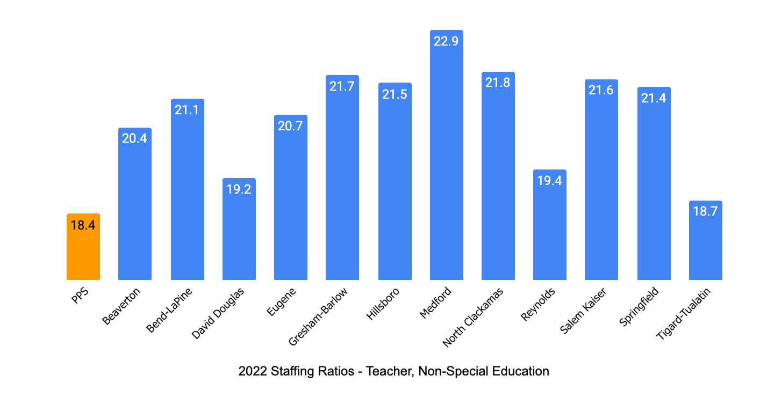
Sustaining A Thriving Workforce
Our focus on school-based supports enables PPS to maintain lower general education student-teacher ratios to Oregon comparison districts.
Notes:
This chart shows the staff to student ratio for gen ed classes from 2022 across the state. PPS’s staff to student ratio is the lowest in the state.

Slide 5
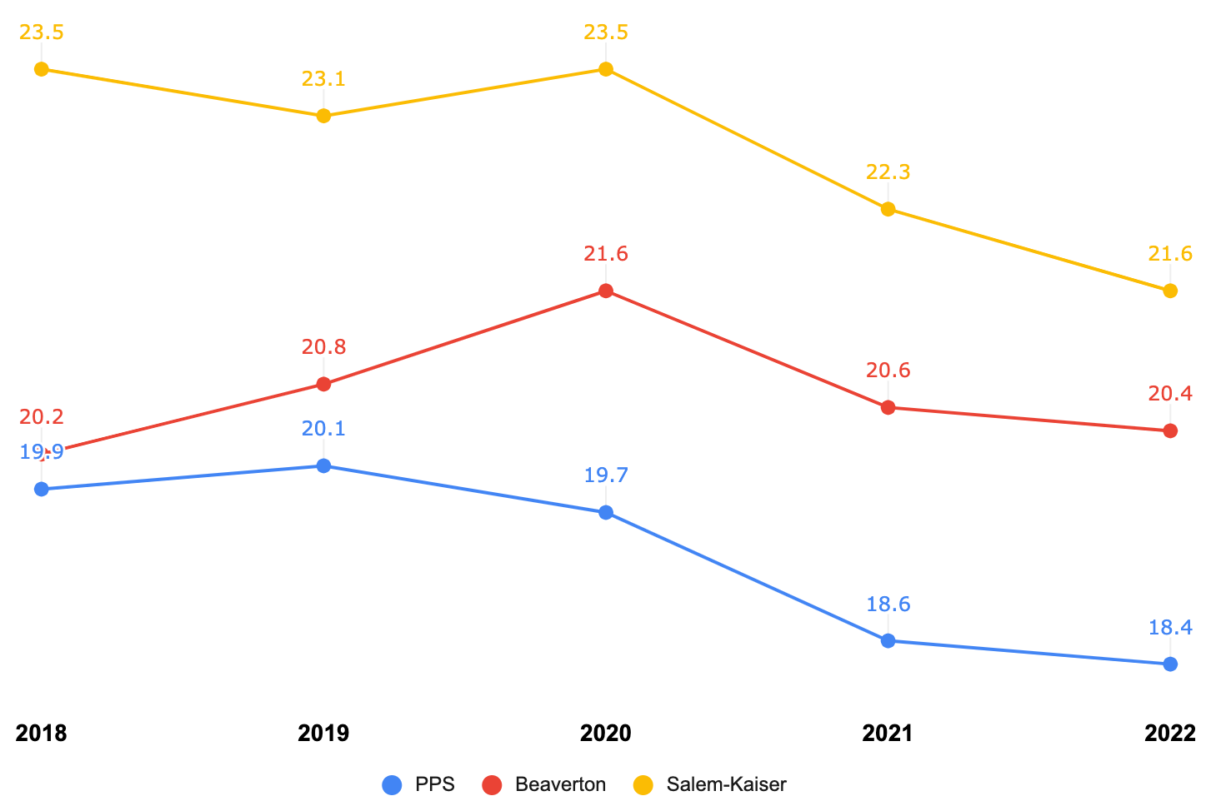
Sustaining A Thriving Workforce
Our focus on school-based supports enables PPS to maintain lower general education student-teacher ratios to Oregon comparison districts.
Notes:
This slide shows the student - teacher trend over the last 6 years. PPS is in blue with the lowest student-teacher ratio when compared to Beaverton and Salem - Kaizer

Slide 6
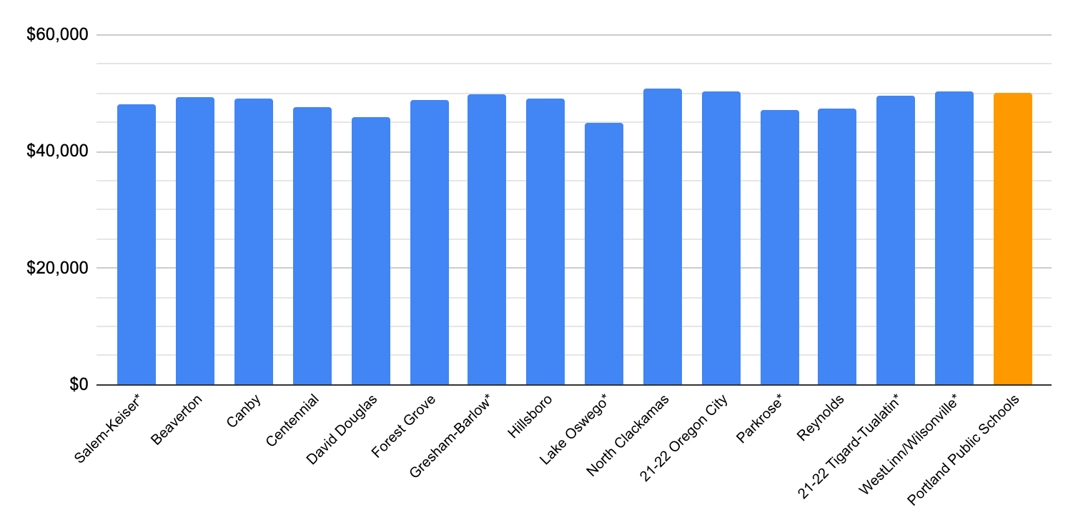
Sustaining A Thriving Workforce
The starting salary a first year classroom educator at PPS is among the highest in Oregon.
(2022-23: $50,020)
Notes:
This chart shows starting teacher salaries across the state. PPS is among the highest starting salary for teachers in the state and has the smallest student to staff ratio across the state.

Slide 7
Sustaining A Thriving Workforce
PPS Educator Teaching Experience vs. Comparison Districts
PPS educators are seasoned professionals. About 50 percent of all PPS educators are at the top of the salary schedule.
This means that about 50% make between $75,000 and $100,000.
Note: Years of experience includes teaching experience in any district
Source: PPS Employee Data, October 2021 and ERS National Comparison Data, SY21-22
Notes:
This slide is from Education Resource Strategies, national non-profit that supports school districts with resource and strategic planning. This data is anonymous, so we don’t know the district’s, but it shows that our educators have more experience, putting them at a higher wage and stay with PPS longer than comparator districts.

Slide 8
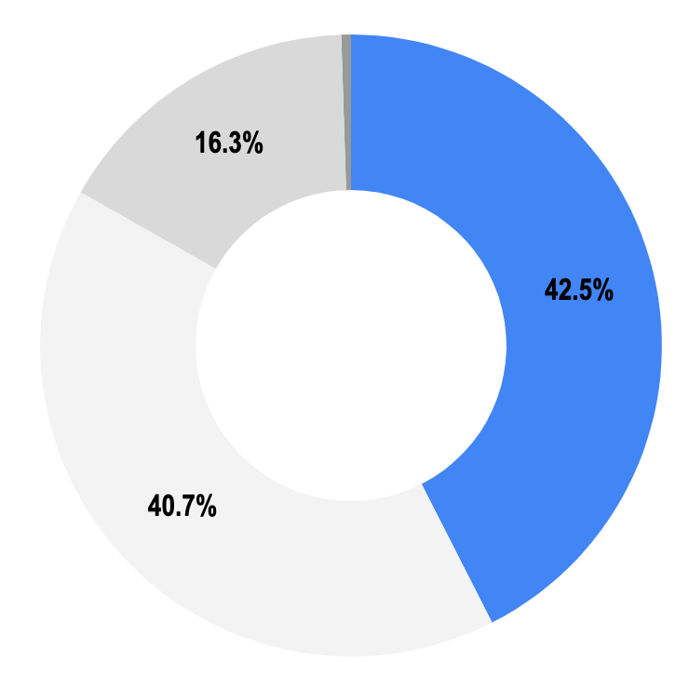
Our Budget
Our $1.88 Billion PPS Budget can be categorized into four funds:
General (42.5% | $804M) Primary source of dollars used for day-to-day operations of the District, this includes funds such as Local Option Levy, Arts Tax and the fund balance.
Special Revenue (16.3% | $311M) Restricted dollars from, Federal (e.g Title, ESSER), Nutrition Services, Individuals with Disabilities Education Act (IDEA), State (e.g. SIA, Measure 98), Local Grants (e.g. Foundations)
Capital Projects and Debt Service (40.7% | $760M) Construction/renovation of school facilities, technology and curriculum upgrades and payment of long-term debt (e.g. PERS, etc)
Internal Service (0.5% | $8.6M) Cost-reimbursement resources (e.g. insurance, worker’s comp)
2022-23 Adopted Budget
Notes:
To help put this into context for our budget, this slide may look familiar as it represents the budget’s 5 major funds.
All of these funds combined make up the total approximately $1.88billion dollar budget. About half of the budget is restricted to activities that can NOT support day to day activities. Such as
Capital Projects & Debt Service funds, the yellow portion of the pie, represent dollars for construction and renovation of school facilities, tech and curriculum and also, the tax collections to pay those bonds back. It is a total of 760 million dollars.
Another major part, is the red slice of the pie, the Special Revenue fund, is comprised of several restricted programs. This includes student investment account dollars, High School Success, Federal Covid relief funds (ESSER), and other federal funded programs like Title programs and our nutrition program.
Lastly, the General Fund, the blue slice, (click for animation) is approximately 804 million dollars. It is the primary source of dollars used for day-to-day operations of the District, and includes funds such as Local Option Levy, Arts Tax and the district’s saving account. Our day to day fund, the general fund, is heavily reliant on enrollment.
Next Slide

Slide 9
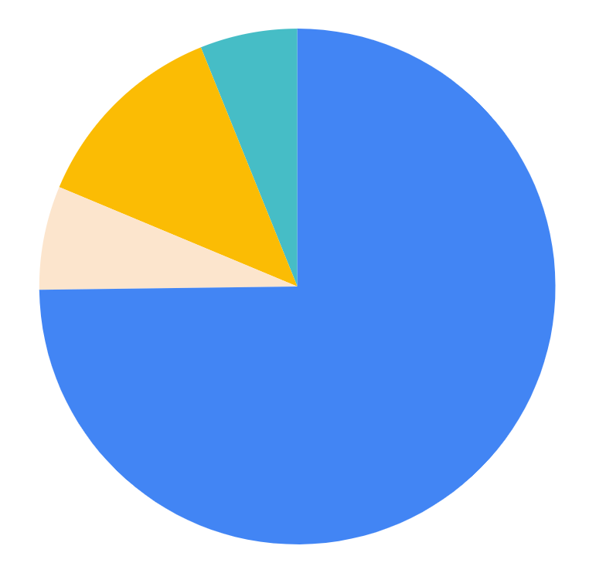
Our Budget
75 percent of PPS general funds pay for salaries and benefits of PPS educators.
74.8% Student Direct Supports | Teachers, counselors, assistant principals, principals, social workers, speech & psychological services
6.5% Support & Enhance Instruction | Curriculum & professional development design roles, planning program evaluation, and assessment roles
12.6% Facility & Student Operational Supports | Custodians, maintenance personnel & bus drivers (does not include nutrition staff because they are funded from the Special Revenue fund)
6.1% Management & Business Operations | Accounting, payroll, procurement, legal, HR, IT, Executive Administration
Notes:
Slide 7
So now, let’s take a look at the General fund. As a reminder, the general fund, is the primary source of dollars used for day-to-day operations of the District, this includes funds such as Local Option Levy, Arts Tax and the fund balance. About 80% of the general fund is invested in people. This slide represents who the various team members: Read slide

Slide 10
Fiscal Uncertainty
2022-23 General Fund End of Year Projections
General Fund | End of Year Projection for 2022-23 in Millions (As of Feb 2023; Subject to Change) | Notes
Projected Revenue | $802 | This is all Gen-Fund revenues; includes approximately $51M of contingency (i.e. fund balance)
Projected Expenses | $729 | Includes $15M in projected savings from current year cost containment activities (approximately $11M from personnel & $4M from non-personnel)
Projected Ending Fund Balance | $73 | It is the goal of the Board to fund and maintain a reserve in the general fund that shall range from 5% ($40M) to 10% ($80M) of annual general fund revenues. $73M is 9%. At the start of the year fund balance was $98.8M (12%).
Current estimate is anticipating $73M of resources available to support next year (FY24) and the following year’s (FY25) budget; however we must also work within the parameters of the minimum 5% fund balance policy. The next slide shows current planning.
Notes:
Nolberto

Slide 11
Fiscal Uncertainty
Preliminary General Fund Budget Projections
General Fund | Projected for 2023-24 in Millions (January 2023) | Projected for 2023-24 in Millions (February 2023) | Projected for 2024-25 in Millions (February 2023) | Notes
Biennial State School Fund (SSF) Budget Assumptions | $9.6 Billion | $9.9 Billion |  | On Feb-22nd Oregon Department of Education (ODE) released initial estimate of State School Fund.
Projected Beginning Fund Balance | $50 | $73 | $50 | Estimated underspend, vacancy savings and cost saving exercises this year will help balance the PPS budget during the next biennium
Projected Revenue | $722 | $730 | $748 | Using info from ODE; this is preliminary and will be finalized by legislature in late Spring. This also includes estimates for non-SSF revenue such as the local option levy (expected to grow by $5M compared to current year).
Projected Total Available Revenue | $772 | $803 | $798 | Total available revenue is fund balance plus projected revenue; fund balance usage must align to board policy
Projected Expenses | $773 | $753 | $776 | This includes preliminary estimates of $20M in savings for next year (FY24). Teams continue to plan & discuss school site staffing and central office savings for next year. Does not include any active reductions for FY25.
Projected Ending Fund Balance | -1 | $50 | $21 | Current projection is that Supt's FY24 proposed budget will meet minimum 5% fund balance target, however, biennium outlook not meeting fund balance requirements (nor capable of rebuilding back to 10%)
5% Fund Balance Floor | $39M | $40 | $40 | Using funds below the 5% threshold would require board approval and be incorporated as part of the budget adoption process.
Notes:
Nolberto
All of this is still preliminary: On-February 22nd, we received our first estimates from the state; while overall revenue estimate for next year is approximately $26M more than this year, our operating costs are also increasing. The Superintendent's proposed budget is scheduled to be release on April 25, 2023.
The degree of budget adjustments to schools will largely be dependent:
Projected revenue… notice a trend where new money coming in is not keeping up with budgeted expenses
Enrollment
Availability of fund balance (i.e. how much $ in savings account after this year)
It’s important to emphasize the critical nature of maintaining the fund balance, the fund balance maintains our casflow in order to pay for bills, for salaries in a timely fashion, but also, it’s also there for emergencies and not meant to prop up day to day operations. At this rate we are projected to use up all of the fund balance into FY2025-26, and that simply isn’t sustainable. Turn it over to Genevieve

Slide 12
Our Compensation Proposal
PPS is proposing a cumulative 7.5% COLA increase for next three years (2.5% increase per year)
For example:
A PPS teacher with a MA and 12 years of experience will see a base salary increase of $6,557 over the next three years.
SY 2022-23: $85,277 → SY 2025-2026: $91,834
That also means that for more than 50 percent of PPS educators, a 5.9% increase* each year of the contract for a cumulative of 17.7% increase for the next three years.
For example:
A PPS teacher with a BA and 4 years of experience will see a base salary increase of $10,729 over the next three years.
SY 2022-23: $57,177 → SY 2025-2026: $67,906
Sustaining A Thriving Workforce
Fiscal
Uncertainty
* Yearly step increases are 3.4%
Notes:
Our obligation to balance a budget is both short and long term, which requires us to forecast variables that we must guess at--state school fund, student enrollment, etc. These unknowns substantially impact our ability to responsibly make financial commitments

Slide 13
Thank you.

Slide 14
Appendix

Slide 15
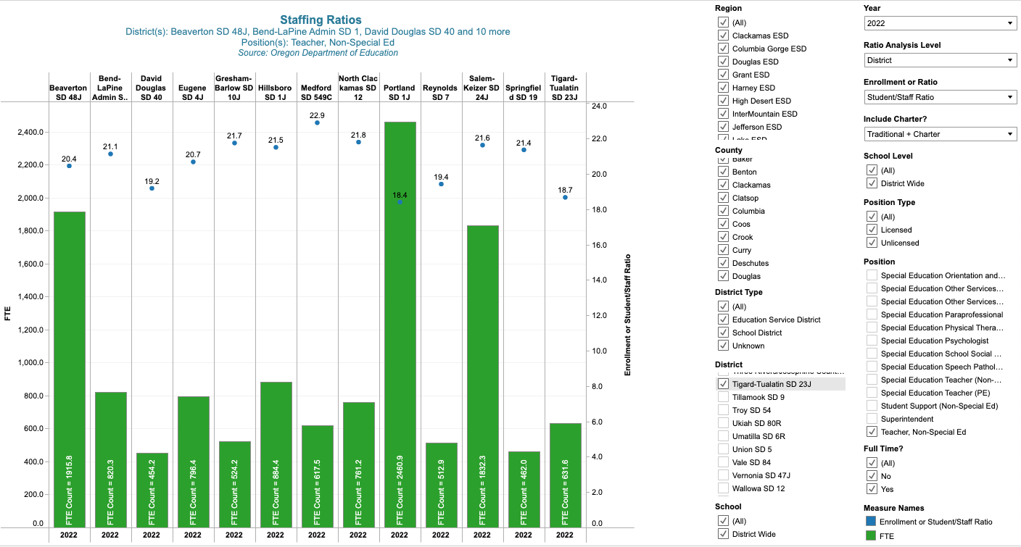
All Classroom Teachers, Non-Special Education, 2022
Notes:
This data is directly from ODE The green bar is total FTE for these positions.
The blue dot is the ratio of these staff to all student enrollment. This slide represents all general classroom teachers, not including special education - it does not include non-classroom based educators (TOSA’s for example)

Slide 16
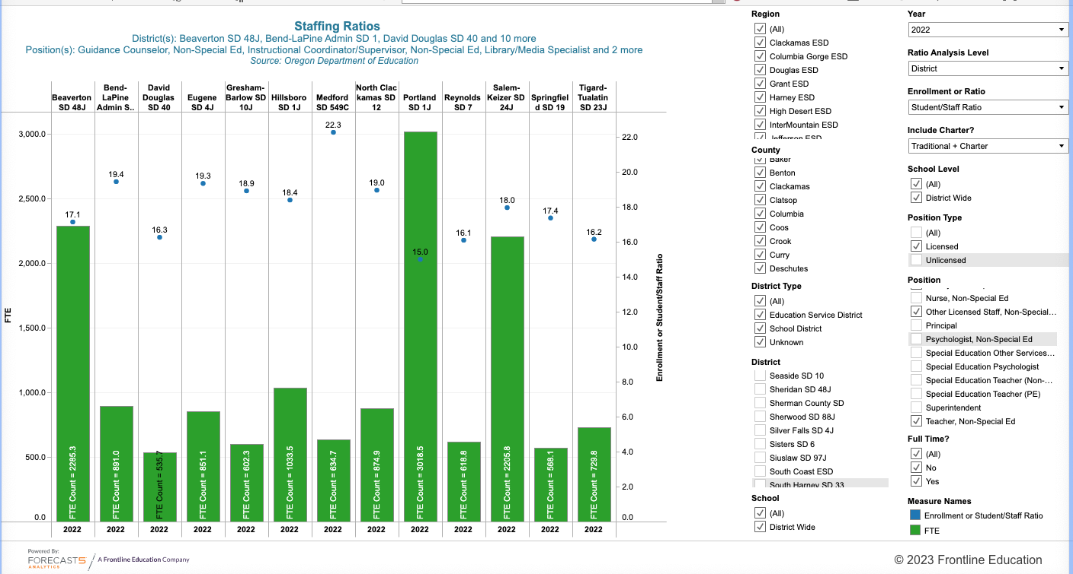
All Non-Classroom Licensed Staff, Non-Special Education, 2022
Notes:
This data is directly from ODE The green bar is total FTE for these positions.
The blue dot is the ratio of these staff to all student enrollment. This slide represents all general education non-classroom licensed staff, not including special education.

Slide 17
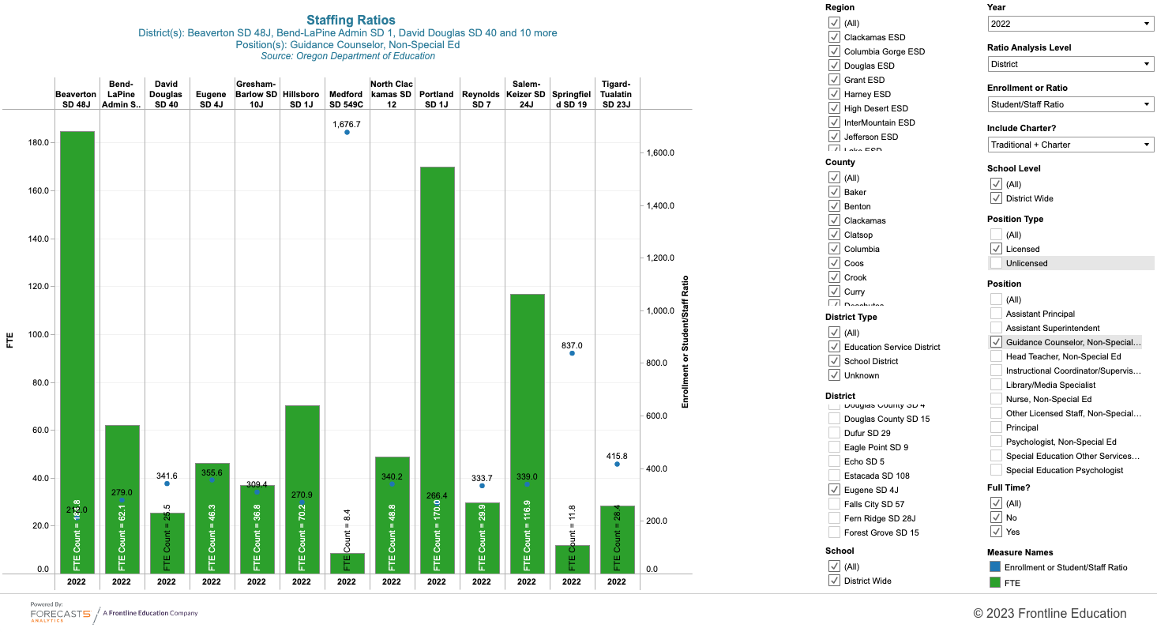
Guidance Counselor, Non-Special Education, 2022
Notes:
This data is directly from ODE The green bar is total FTE for these positions.
The blue dot is the ratio of these staff to all student enrollment. This slide includes guidance counselors, not including special education

Slide 18
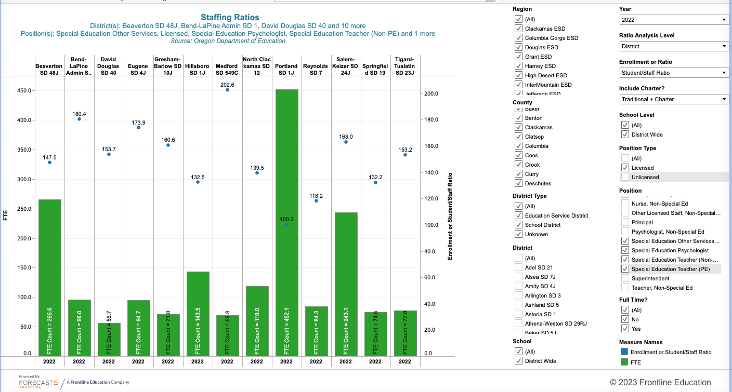
All Licensed Special Education, 2022
Notes:
This data is directly from ODE The green bar is total FTE for these positions.
The blue dot is the ratio of these staff to all student enrollment. This slide represents all special education educators, classroom and non-classroom (school psychs, SLPs, etc.)

Slide 19
Link to ODE Program Budgeting & Accounting Manual (PBAM): https://www.oregon.gov/ode/schools-and-districts/grants/Documents/Program%20Budgeting%20and%20Accounting%20Manual%20(PBAM)%20-%202019%20Edition%20(Effective%20as%20of%20July%201,%202020).pdf
Notes:
The graphical data are from ODE and this provides a few additional notes regarding the data.

Slide 20
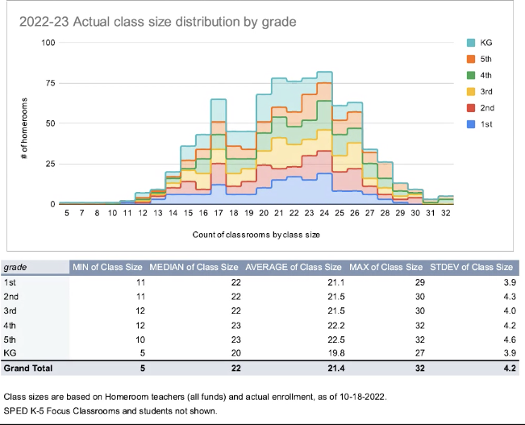
Notes:
PPS reported on classroom thresholds earlier this year with the school board - this is PPS provided data. Homerooms are allocated based on the below class size maximums and result in the following class size ranges.
The previous Middle School Staffing Formula was aligned to how we staff K-5 schools. The Middle School Staffing Formula is changing to align with the High School Formula to provide a more equitable distribution of FTE across comprehensive Middle Schools. There is a base allocation and a ratio based on the school size, with differentiation for schools on a 6 and 7 period day, whether a school has Immersion, and if the school is Title-I. Immersion schools receive an additional 1.0 FTE. The K-8 middle grade formula is not changing.

Slide 21
Classroom Staffing Thresholds, School Year 2024
Elementary School
 | CSI Schools |  | Title I Schools |  | Other Schools
Grade | Maximum Class Size | Class Size Ranges | Maximum Class Size | Class Size Ranges | Maximum Class Size | Class Size Ranges
KG | 24 | 13-24 | 28 | 15-28 | 29 | 15-29
1 | 26 | 14-26 | 28 | 15-28 | 31 | 16-31
2 | 28 | 15-28 | 28 | 15-28 | 32 | 17-32
3 | 28 | 15-28 | 28 | 15-28 | 33 | 17-33
4 | 32 | 17-32 | 32 | 17-32 | 33 | 17-33
5 | 32 | 17-32 | 32 | 17-32 | 33 | 17-33
Middle School (Updated)
High School
 |  | Title 7 Period | Other 7 Period | Other 6 Period
Small <550 | Ratio | 22:1 | 23:1 | 24:1
 | Base | 2.0 FTE | 1.0 FTE | 0.0 FTE
Large >550 | Ratio | 25:1 | 27:1 | 24:1
 | Base | 5.0 FTE | 4.5 FTE | 0.0 FTE
 |  | TSI / CSI Schools | Other Schools
Small Schools < 1,000 | Ratio | 23.4:1 | 24.2:1
 | Base | 5 FTE | 5 FTE
Large Schools >1,000 | Ratio | 25.8:1 | 26.8:1
 | Base | 9 FTE | 9 FTE
Notes:
PPS reported on classroom thresholds earlier this year with the school board - this is PPS provided data. Homerooms are allocated based on the below class size maximums and result in the following class size ranges.
The previous Middle School Staffing Formula was aligned to how we staff K-5 schools. The Middle School Staffing Formula is changing to align with the High School Formula to provide a more equitable distribution of FTE across comprehensive Middle Schools. There is a base allocation and a ratio based on the school size, with differentiation for schools on a 6 and 7 period day, whether a school has Immersion, and if the school is Title-I. Immersion schools receive an additional 1.0 FTE. The K-8 middle grade formula is not changing.

